Slide 1
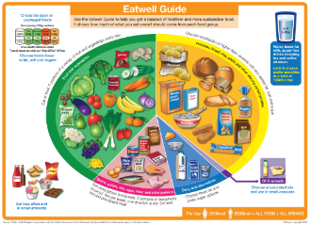
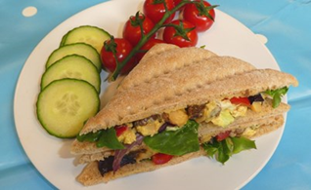

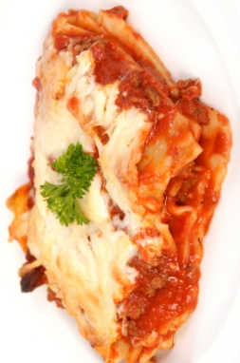
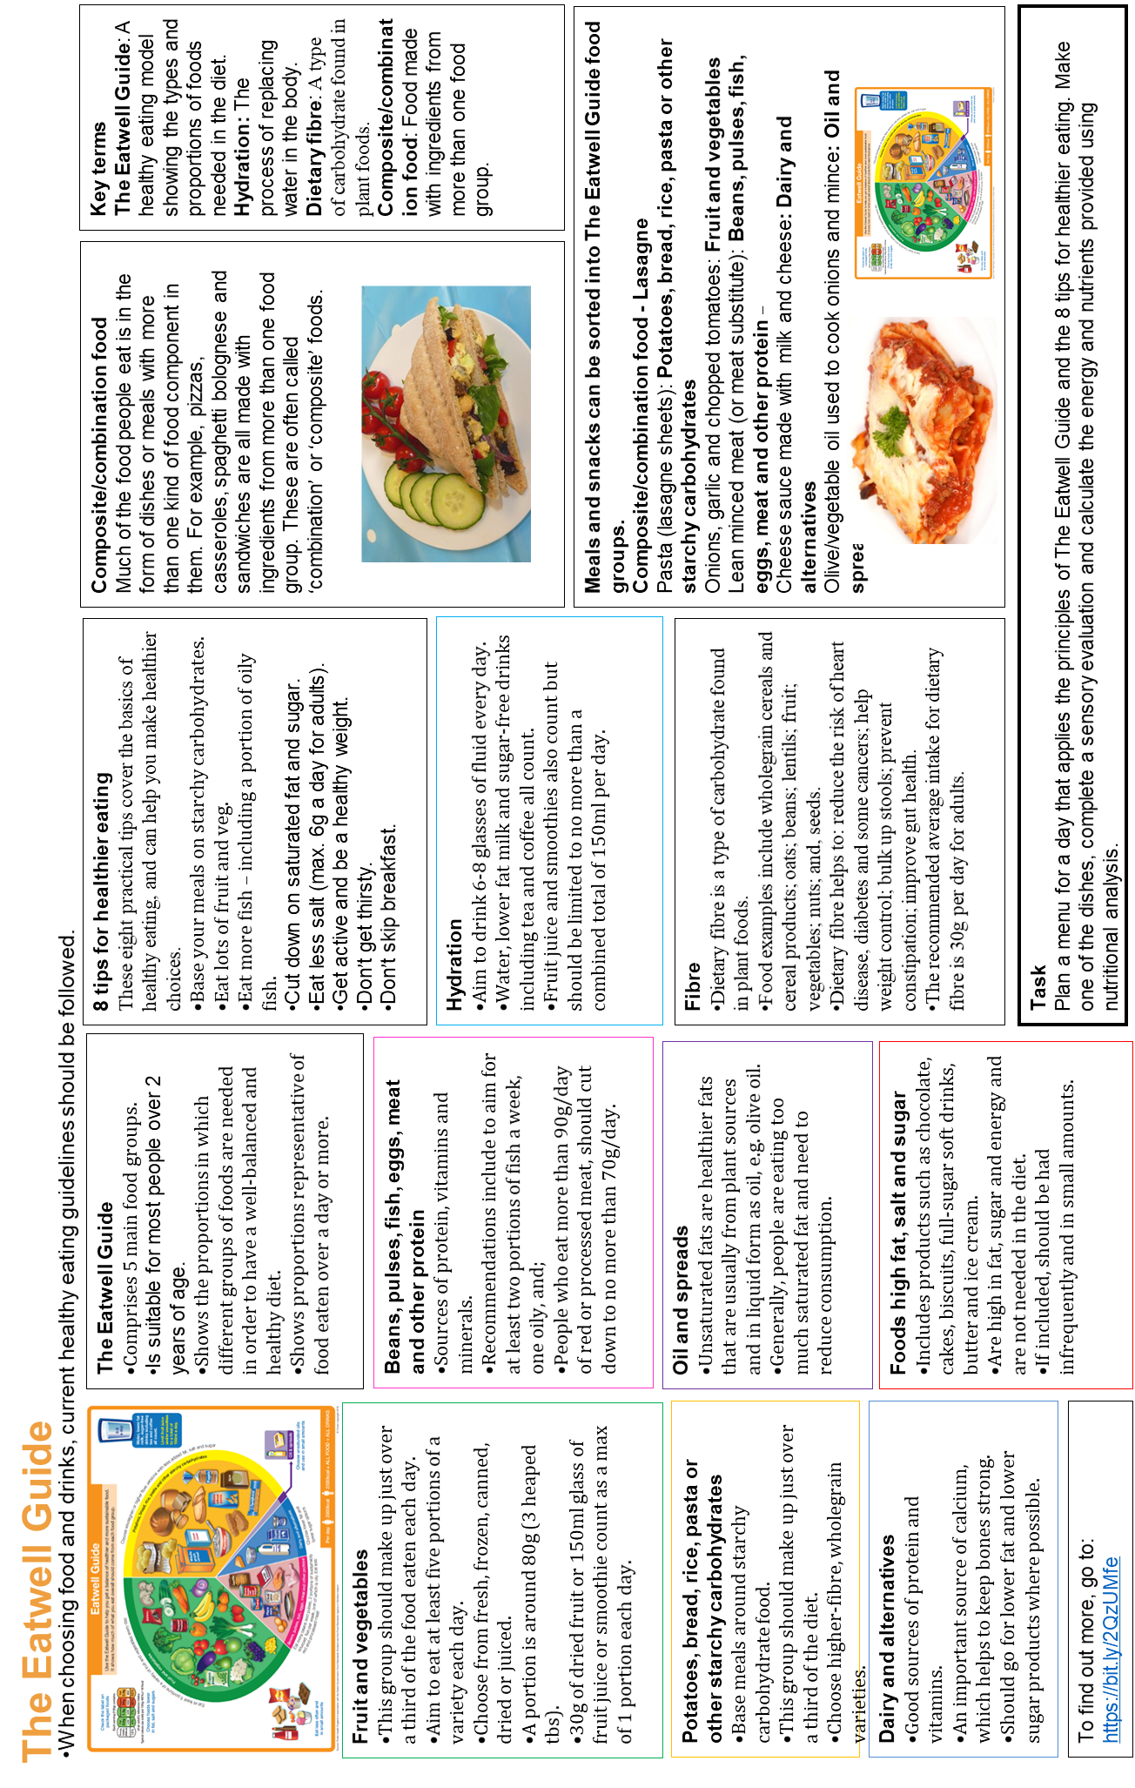

Key terms
The Eatwell Guide: A healthy eating model showing the types and proportions of foods needed in the diet.
Hydration: The process of replacing water in the body.
Dietary fibre: A type of carbohydrate found in plant foods.
Composite/combination food: Food made with ingredients from more than one food group.
Meals and snacks can be sorted into The Eatwell Guide food groups.
Composite/combination food - Lasagne
Pasta (lasagne sheets): Potatoes, bread, rice, pasta or other starchy carbohydrates
Onions, garlic and chopped tomatoes: Fruit and vegetables
Lean minced meat (or meat substitute): Beans, pulses, fish, eggs, meat and other protein –
Cheese sauce made with milk and cheese: Dairy and alternatives
Olive/vegetable oil used to cook onions and mince: Oil and spreads
Composite/combination food
Much of the food people eat is in the form of dishes or meals with more than one kind of food component in them. For example, pizzas, casseroles, spaghetti bolognese and sandwiches are all made with ingredients from more than one food group. These are often called ‘combination’ or ‘composite’ foods.
Task
Plan a menu for a day that applies the principles of The Eatwell Guide and the 8 tips for healthier eating. Make one of the dishes, complete a sensory evaluation and calculate the energy and nutrients provided using nutritional analysis.
8 tips for healthier eating
These eight practical tips cover the basics of healthy eating, and can help you make healthier choices.
Base your meals on starchy carbohydrates.
Eat lots of fruit and veg.
Eat more fish – including a portion of oily fish.
Cut down on saturated fat and sugar.
Eat less salt (max. 6g a day for adults).
Get active and be a healthy weight.
Don’t get thirsty.
Don’t skip breakfast.
Fibre
Dietary fibre is a type of carbohydrate found in plant foods.
Food examples include wholegrain cereals and cereal products; oats; beans; lentils; fruit; vegetables; nuts; and, seeds.
Dietary fibre helps to: reduce the risk of heart disease, diabetes and some cancers; help weight control; bulk up stools; prevent constipation; improve gut health.
The recommended average intake for dietary fibre is 30g per day for adults.
Hydration
Aim to drink 6-8 glasses of fluid every day.
Water, lower fat milk and sugar-free drinks including tea and coffee all count.
Fruit juice and smoothies also count but should be limited to no more than a combined total of 150ml per day.
The Eatwell Guide
Comprises 5 main food groups.
Is suitable for most people over 2 years of age.
Shows the proportions in which different groups of foods are needed in order to have a well-balanced and healthy diet.
Shows proportions representative of food eaten over a day or more.
Beans, pulses, fish, eggs, meat and other protein
Sources of protein, vitamins and minerals.
Recommendations include to aim for at least two portions of fish a week, one oily, and;
People who eat more than 90g/day of red or processed meat, should cut down to no more than 70g/day.
Foods high fat, salt and sugar
Includes products such as chocolate, cakes, biscuits, full-sugar soft drinks, butter and ice cream.
Are high in fat, sugar and energy and are not needed in the diet.
If included, should be had infrequently and in small amounts.
Oil and spreads
Unsaturated fats are healthier fats that are usually from plant sources and in liquid form as oil, e.g. olive oil.
Generally, people are eating too much saturated fat and need to reduce consumption.
When choosing food and drinks, current healthy eating guidelines should be followed.
The Eatwell Guide
Fruit and vegetables
This group should make up just over a third of the food eaten each day.
Aim to eat at least five portions of a variety each day.
Choose from fresh, frozen, canned, dried or juiced.
A portion is around 80g (3 heaped tbs).
30g of dried fruit or 150ml glass of fruit juice or smoothie count as a max of 1 portion each day.
Potatoes, bread, rice, pasta or other starchy carbohydrates
Base meals around starchy carbohydrate food.
This group should make up just over a third of the diet.
Choose higher-fibre, wholegrain varieties.
Dairy and alternatives
Good sources of protein and vitamins.
An important source of calcium, which helps to keep bones strong.
Should go for lower fat and lower sugar products where possible.
To find out more, go to: https://bit.ly/2QzUMfe

Slide 2
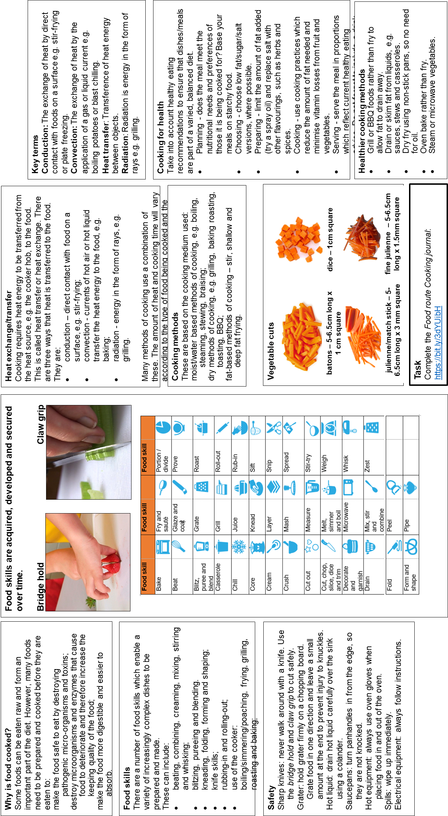
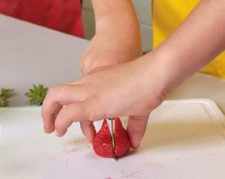
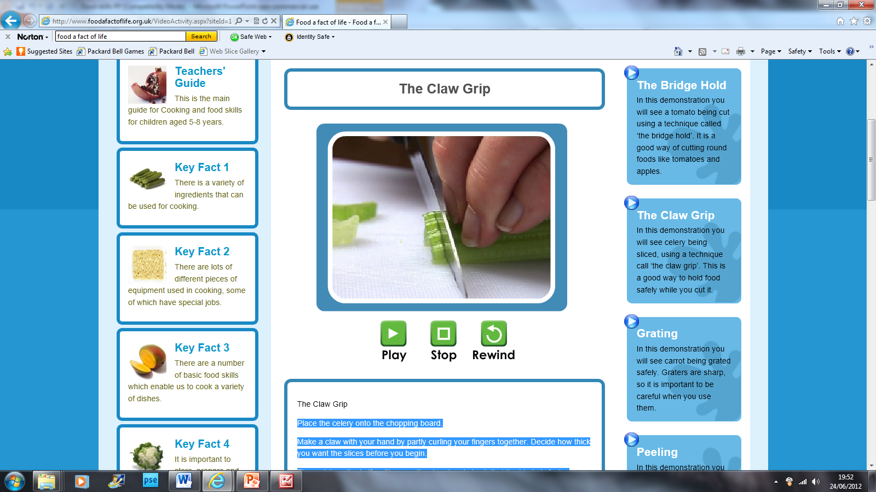
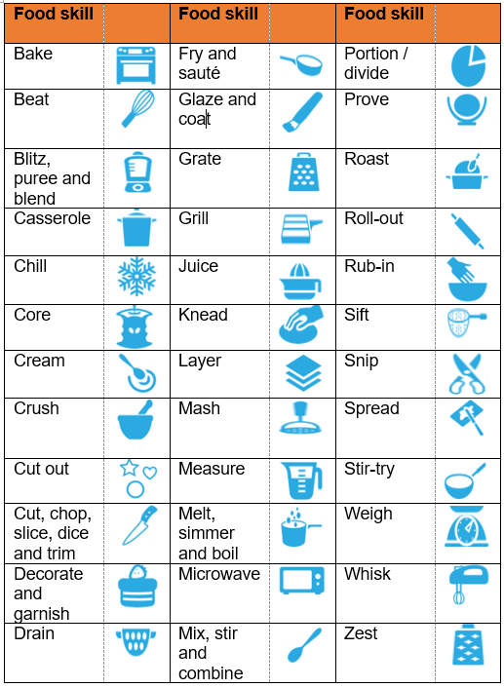
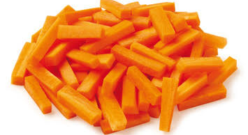
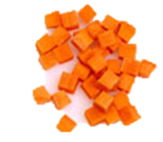
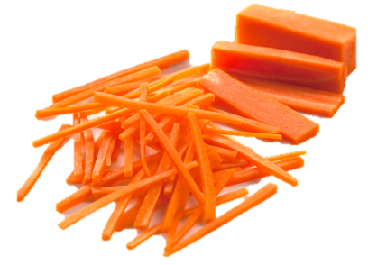
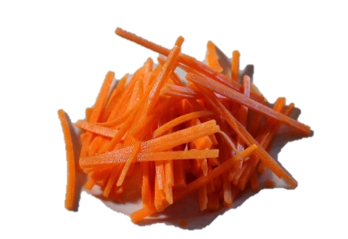
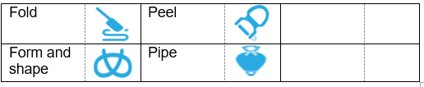
Why is food cooked?
Some foods can be eaten raw and form an important part of the diet. However, many foods need to be prepared and cooked before they are eaten to:
make the food safe to eat by destroying pathogenic micro-organisms and toxins;
destroy microorganisms and enzymes that cause food to deteriorate and therefore increase the keeping quality of the food;
make the food more digestible and easier to absorb.
Food skills are acquired, developed and secured over time.
Bridge hold Claw grip
Heat exchange/transfer
Cooking requires heat energy to be transferred from the heat source, e.g. the cooker hob, to the food. This is called heat transfer or heat exchange. There are three ways that heat is transferred to the food.
They are:
conduction – direct contact with food on a surface, e.g. stir-frying;
convection - currents of hot air or hot liquid transfer the heat energy to the food, e.g. baking;
radiation - energy in the form of rays, e.g. grilling.
Many methods of cooking use a combination of these. The amount of heat and cooking time will vary according to the type of food being cooked and the method being used.
Key terms
Conduction: The exchange of heat by direct contact with foods on a surface e.g. stir-frying or plate freezing.
Convection: The exchange of heat by the application of a gas or liquid current e.g. boiling potatoes or blast chilling.
Heat transfer: Transference of heat energy between objects.
Radiation: Radiation is energy in the form of rays e.g. grilling.
Food skills
There are a number of food skills which enable a variety of increasingly complex dishes to be prepared and made.
These can include:
beating, combining, creaming, mixing, stirring and whisking;
blitzing, pureeing and blending.
kneading, folding, forming and shaping;
knife skills;
rubbing-in and rolling-out;
use of the cooker: boiling/simmering/poaching, frying, grilling, roasting and baking;
Cooking for health
Take into account healthy eating recommendations to ensure that dishes/meals are part of a varied, balanced diet.
Planning - does the meal meet the nutritional needs and preferences of those it is being cooked for? Base your meals on starchy food.
Choosing - choose low fat/sugar/salt versions, where possible.
Preparing - limit the amount of fat added (try a spray oil) and replace salt with other flavourings, such as herbs and spices.
Cooking - use cooking practices which reduce the amount of fat needed and minimise vitamin losses from fruit and vegetables.
Serving - serve the meal in proportions which reflect current healthy eating advice. Do not forget to include a drink.
Cooking methods
These are based on the cooking medium used:
moist/water based methods of cooking, e.g. boiling, steaming, stewing, braising;
dry methods of cooking, e.g. grilling, baking roasting, toasting, BBQ;
fat-based methods of cooking – stir, shallow and deep fat frying.
Cooking
A broad range of ingredients, equipment, food skills and techniques, and cooking methods are used to achieve successful results.
Recipes and cooking methods can be modified to help meet current healthy eating messages.
Safety
Sharp knives: never walk around with a knife. Use the bridge hold and claw grip to cut safely.
Grater: hold grater firmly on a chopping board. Grate food in one direction and leave a small amount at the end to prevent injury to knuckles.
Hot liquid: drain hot liquid carefully over the sink using a colander.
Saucepans: turn panhandles in from the edge, so they are not knocked.
Hot equipment: always use oven gloves when placing food in and out of the oven.
Spills: wipe up immediately.
Electrical equipment: always follow instructions.
Vegetable cuts
batons – 5-6.5cm long x 1 cm square
dice – 1cm square
Healthier cooking methods
Grill or BBQ foods rather than fry to allow fat to drain away.
Drain or skim fat from liquids, e.g. sauces, stews and casseroles.
Dry fry using non-stick pans, so no need for oil.
Oven bake rather than fry.
Steam or microwave vegetables.
julienne/match stick – 5-6.5cm long x 3 mm square
fine julienne – 5-6.5cm long x 1.5mm square
Task
Complete the Food route Cooking journal:
https://bit.ly/3dYUibH

Slide 3
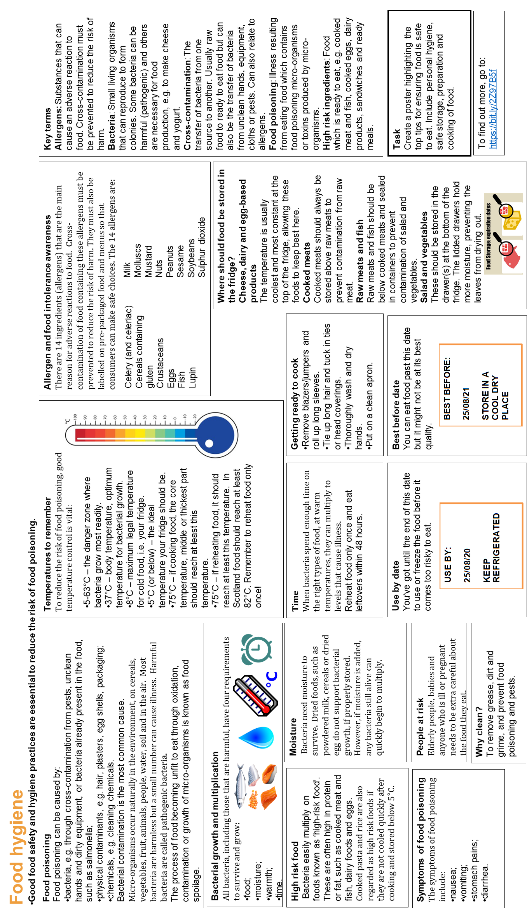
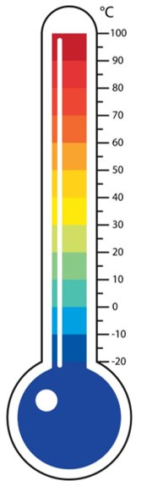
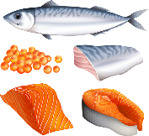



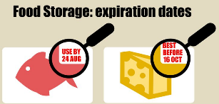
Food hygiene
Good food safety and hygiene practices are essential to reduce the risk of food poisoning.
Food poisoning
Food poisoning can be caused by:
bacteria, e.g. through cross-contamination from pests, unclean hands and dirty equipment, or bacteria already present in the food, such as salmonella;
physical contaminants, e.g. hair, plasters, egg shells, packaging;
chemicals, e.g. cleaning chemicals.
Bacterial contamination is the most common cause.
Micro-organisms occur naturally in the environment, on cereals, vegetables, fruit, animals, people, water, soil and in the air. Most bacteria are harmless but a small number can cause illness. Harmful bacteria are called pathogenic bacteria.
The process of food becoming unfit to eat through oxidation, contamination or growth of micro-organisms is known as food spoilage.
Temperatures to remember
To reduce the risk of food poisoning, good temperature control is vital:
Allergen and food intolerance awareness
There are 14 ingredients (allergens) that are the main reason for adverse reactions to food. Cross-contamination of food containing these allergens must be prevented to reduce the risk of harm. They must also be labelled on pre-packaged food and menus so that consumers can make safe choices. The 14 allergens are:
Key terms
Allergens: Substances that can cause an adverse reaction to food. Cross-contamination must be prevented to reduce the risk of harm.
Bacteria: Small living organisms that can reproduce to form colonies. Some bacteria can be harmful (pathogenic) and others are necessary for food production, e.g. to make cheese and yogurt.
Cross-contamination: The transfer of bacteria from one source to another. Usually raw food to ready to eat food but can also be the transfer of bacteria from unclean hands, equipment, cloths or pests. Can also relate to allergens.
Food poisoning: Illness resulting from eating food which contains food poisoning micro-organisms or toxins produced by micro-organisms.
High risk ingredients: Food which is ready to eat, e.g. cooked meat and fish, cooked eggs, dairy products, sandwiches and ready meals.
5-63°C – the danger zone where bacteria grow most readily.
37°C – body temperature, optimum temperature for bacterial growth.
8°C – maximum legal temperature for cold food, i.e. your fridge.
5°C (or below) – the ideal temperature your fridge should be.
75°C – if cooking food, the core temperature, middle or thickest part should reach at least this temperature.
75°C – if reheating food, it should reach at least this temperature. In Scotland food should reach at least 82°C. Remember to reheat food only once!
Celery (and celeriac)
Cereals containing gluten
Crustaceans
Eggs
Fish
Lupin
Milk
Molluscs
Mustard
Nuts
Peanuts
Sesame
Soybeans
Sulphur dioxide
Bacterial growth and multiplication
All bacteria, including those that are harmful, have four requirements to survive and grow:
food;
moisture;
warmth;
time.
Where should food be stored in the fridge?
Cheese, dairy and egg-based products
The temperature is usually coolest and most constant at the top of the fridge, allowing these foods to keep best here.
Cooked meats
Cooked meats should always be stored above raw meats to prevent contamination from raw meat.
Raw meats and fish
Raw meats and fish should be below cooked meats and sealed in containers to prevent contamination of salad and vegetables.
Salad and vegetables
These should be stored in the drawer(s) at the bottom of the fridge. The lidded drawers hold more moisture, preventing the leaves from drying out.
High risk food
Bacteria easily multiply on foods known as ‘high-risk food’. These are often high in protein or fat, such as cooked meat and fish, dairy foods and eggs. Cooked pasta and rice are also regarded as high risk foods if they are not cooled quickly after cooking and stored below 5°C.
Moisture
Bacteria need moisture to survive. Dried foods, such as powdered milk, cereals or dried egg do not support bacterial growth, if properly stored. However, if moisture is added, any bacteria still alive can quickly begin to multiply.
Time
When bacteria spend enough time on the right types of food, at warm temperatures, they can multiply to levels that cause illness.
Reheat food only once and eat leftovers within 48 hours.
Getting ready to cook
Remove blazers/jumpers and roll up long sleeves.
Tie up long hair and tuck in ties or head coverings.
Thoroughly wash and dry hands.
Put on a clean apron.
Use by date
You’ve got until the end of this date to use or freeze the food before it comes too risky to eat.
Best before date
You can eat food past this date but it might not be at its best quality.
Task
Create a poster highlighting the top tips for ensuring food is safe to eat. Include personal hygiene, safe storage, preparation and cooking of food.
Symptoms of food poisoning
The symptoms of food poisoning include:
nausea;
vomiting;
stomach pains;
diarrhea.
People at risk
Elderly people, babies and anyone who is ill or pregnant needs to be extra careful about the food they eat.
Why clean?
To remove grease, dirt and grime, and prevent food poisoning and pests.
To find out more, go to: https://bit.ly/2Z97B5f

Slide 4
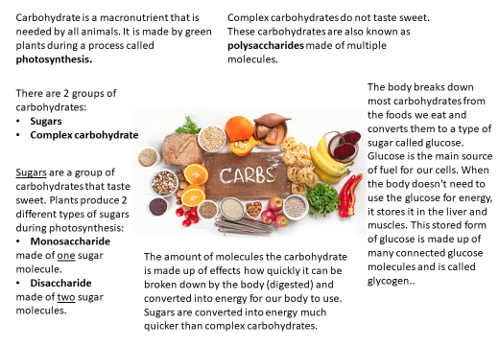
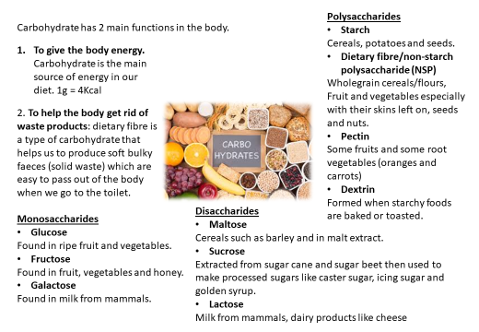
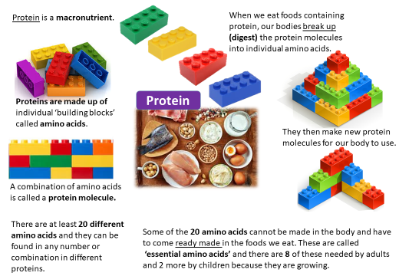
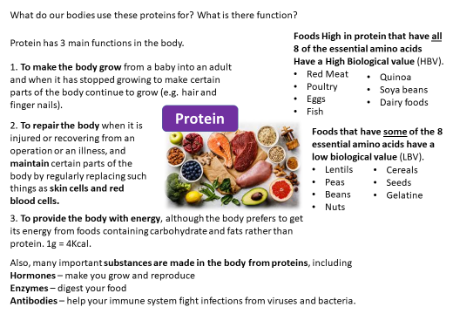

Slide 5
