Slide 1
Year 10 Parents’ Information Evening
Wednesday 15th September, 2021

Slide 2
Head Teacher’s welcome:

Slide 3
Quality of Education: Diarmaid Casey
Overview:
Year 10 curriculum
Remote curriculum
Adapted curriculum
Assessment
Classroom expectations / Attitude to Learning
Homework

Slide 4
Year 10 curriculum:
We aim to provide a broad and balanced curriculum to support all of our students to achieve their potential.
The purpose of the curriculum is to develop the deep skills and knowledge that will allow students to thrive in life beyond the academy.

Slide 5
Year 10 curriculum: Broad, balanced and ambitious
Core curriculum:
English
Maths
Science
Core PE
PSHE
Option 1:
Geography
History
French
2 from option the following:
Art
BTEC Sport
Creative iMedia
DT Graphics
DT Resistant Materials
Engineering
Food Technology
Health and Social Care
Music
Performing Arts
R.S.
Tourism

Slide 6
Sequenced curriculum:

Slide 7
Remote curriculum:
In the event that your child has to isolate or that the school is closed, teaching will take place remotely.
Lessons can be accessed via the website www.birleysecondaryacademy.co.uk or by logging into Office365 and choosing SharePoint.
If your child does not have access to a laptop or computer, please let us know immediately and we will provide, either a laptop or paper resources.

Slide 8
The Adapted curriculum:
The Adapted Curriculum team have responsibility for any student who:
Has a SEN or when a SEN is being investigated
Whose provision is in the Integrated Resource (I.R.)
Who is a Looked After Child

Slide 9
The Adapted curriculum:
Support is available in the form of:
Advice on issues related to SEN or Social, Emotional and Mental Health
Meeting with parents to discuss any concerns they may have about their child’s development or learning difficulties
Assessments of individual pupils to identify need
Referrals may be made to a range of other professionals such as:
Educational Psychologist, Speech and Language Therapist and Specialist Teacher Advisors in the City
SEND drop in A virtual SEND drop in session will be available every Tuesday from 4-6pm. These will be short meetings that are held without an appointment. Following on from these meetings a longer meeting will be arranged, if needed.

Slide 10
Assessment in Year 10:
3 forms of assessment:
Day to day assessment, e.g. teacher questioning, quizzes, etc.
Summative assessments
Typically students complete 2/3 summative assessments in most subjects per half term.
These are endpoint assessments that are carefully designed to assess students knowledge, skills and/or understanding.
Standardised tests:
Reading age

Slide 11
Assessment weeks in Year 10:
Over the year there will be three formal assessment weeks in which students will complete assessments in most subjects.
After each assessment point, parents/carers will receive a written report containing their son/daughter’s current attainment in each subject as well as an attitude to learning grade, alongside rewards, behaviour and attendance data.
Year 10 Assessment weeks 2021-22
Assessment 1 | 1st November 2021
Assessment 2 | 21st February 2022
Assessment 3 | 27th June 2022 (Mock exams)

Slide 12
Homework: Manageable and meaningful
The homework framework ensures that The Birley Academy’s approach to homework is clear and based on research and parental feedback.
The Academy recognises that homework should be manageable (time specific, pre-planned and published) and meaningful (compliments the curriculum).
Y10 homework will come from all subjects and will be set weekly.

Slide 13
Year 10 homework:
In Y10 homework will take the form of:
Extended writing tasks
Exam style question papers (with a focus on taught topics)
Preparation for assessments
Drafting of projects
Use of Hegartymaths
Pre-reading
Memorisation using knowledge organisers

Slide 14
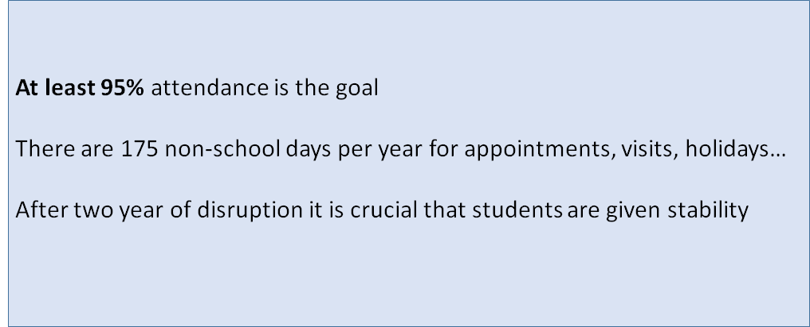
Behaviour and attitudes: Mark Jones

Slide 15
% | Days Absent
85 | 29 days off
86 | 27 days off
87 | 25 days off
88 | 23 days off
89 | 21 days off
90 | 19 days off
91 | 17 days off
92 | 15 days off
93 | 13 days off
94 | 11 days off
95 | 9 days off
96 | 7 days off
97 | 5 days off
98 | 4 days off
99 | 2 days off
100 | 0 days off

Slide 16
Culture within our Academy
"You own your own behaviour"

Slide 17
Go 4 Schools
Behaviour Improvement System
Detentions

Slide 18
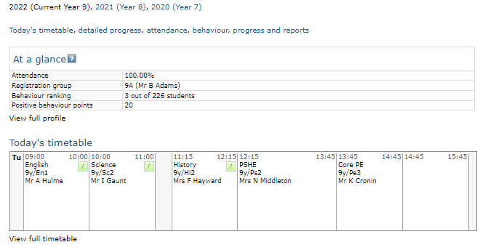
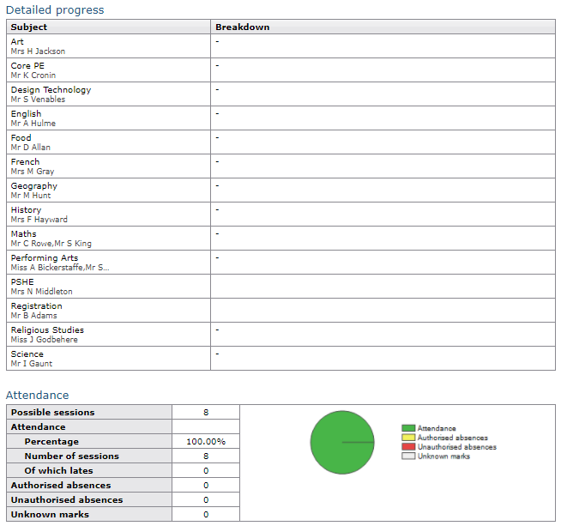
Go 4 Schools

Slide 19
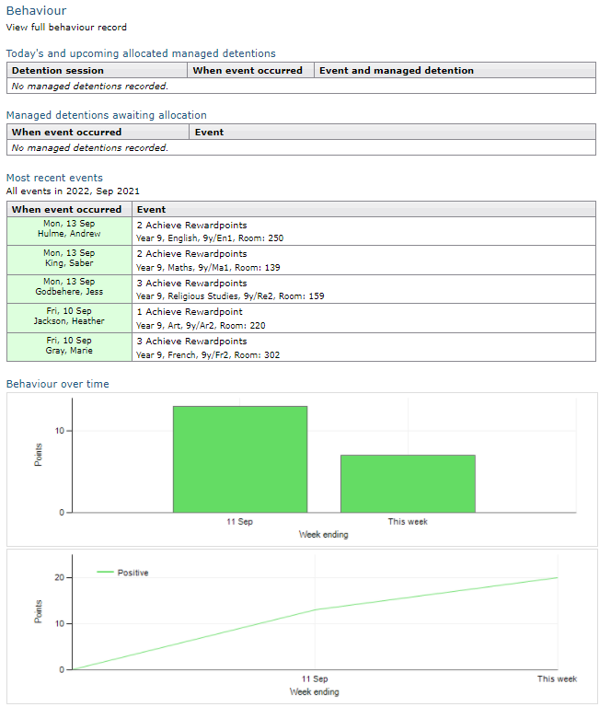
Go 4 Schools

Slide 20
Behaviour Improvement System
Remind
1 Behaviour point
Restorative
2 Behaviour points
Intervention
3 Behaviour points
Warn
You will receive a reminder from your teacher to help you change your behaviour.
Logged on your profile
Logged on your profile
Strategies used to prevent need for restorative.
Student given time to improve behaviour.
Tutors to monitor and challenge.
Sticker in your planner to arrange restorative meeting. Teacher signs sticker to complete. Not attending will lead to intervention.
Either failing restorative or refusing to continue learning elsewhere.
30 Minute detention the same day.
Logged on your profile
At this stage you will not receive any behaviour points.
If your behaviour doesn’t improve the formal behaviour system will begin.

Slide 21
Detentions
Monday | Tuesday | Wednesday | Thursday | Friday
KS3 – (14:45-15:15) Dining Hall | KS3 – (14:45-15:15) Dining Hall | KS3 – (14:45-15:15) Dining Hall | KS3 – (14:45-15:15) Dining Hall | KS3 – (14:45-15:15) Dining Hall
KS4 – (14:55-15:25) Main Hall | KS4 – (14:55-15:25) Main Hall | KS4 – (14:55-15:25) Main Hall | KS4 – (14:55-15:25) Main Hall | KS4 – (14:55-15:25) Main Hall
 | Leadership – (14:45 – 15:15) Training Room |  | Leadership – (14:45 – 15:15) Training Room

Slide 22
Rewards
Pupils can earn reward points
During lessons
In social times
Extra Curricular activities and events
Volunteering
Out of school activities

Slide 23
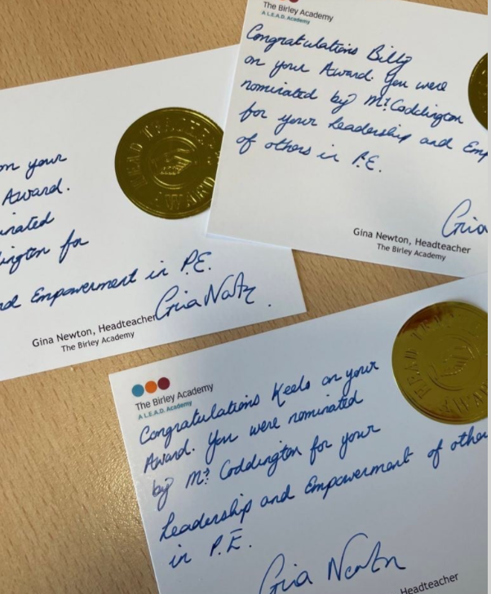
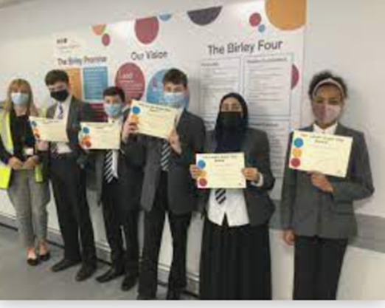
Rewards
We reward students in a variety of ways. Some examples include;
Praise
Encouragement
Certificates
Post Cards
Positive phone call/email home
Reward points on Go4School
Headteachers award
Recognition on social media

Slide 24
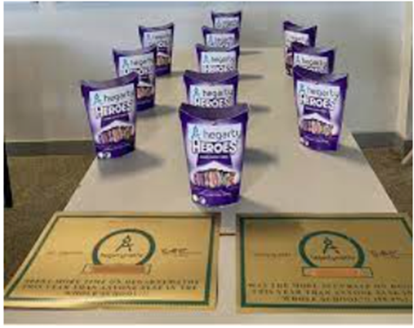
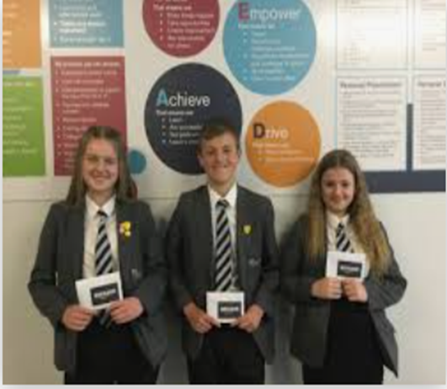
Celebration events
In addition we also have
Celebration assemblies run by progress leaders
Grand celebration evenings
Reward events/opportunities
Prizes/vouchers
Reward badges

Slide 25
Reward Certificates

Slide 26
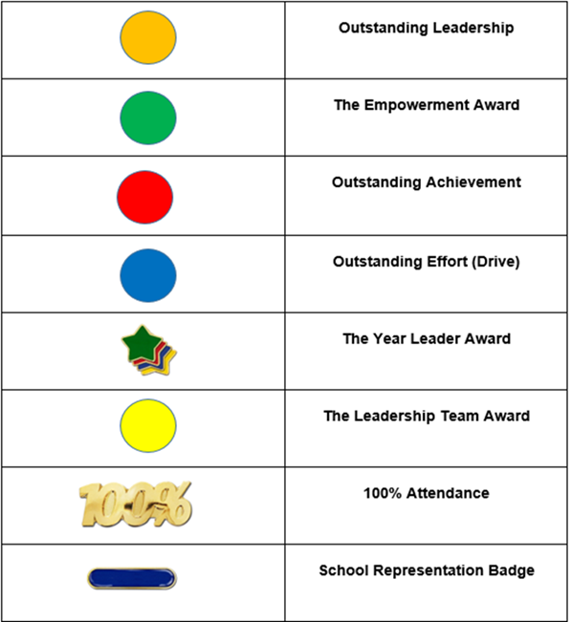
Reward Badges
As part of our rewards system if your child wins an award at one of our celebration evenings they maybe issued with one of the badges.
The aim is to collect all of these badges by the time they reach Year 11.

Slide 27
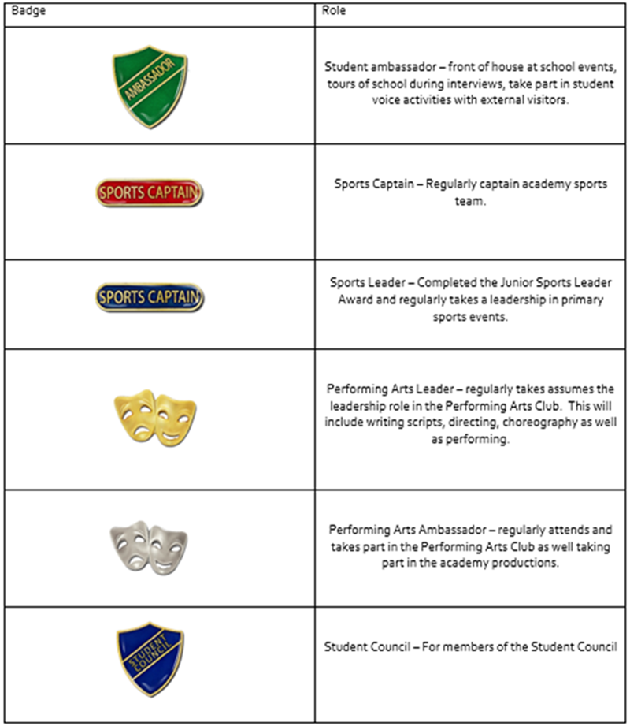
Reward Badges
Student Leadership badges
Students who regularly take part in these activities are issued with a badge to identify their role.
They are also regularly awarded through bonus reward points, celebration breakfasts and lunches and fun opportunities/ activities throughout the year

Slide 28
Enrichment
Enrichment gives pupils opportunities to try new and varied activities that may not strictly fit into the curriculum, but that develop character, resilience and motivation, and encourage them to pursue wider goals.
We promote enrichment activities through a range of:
Extra curricular activities
School Trips
School Awards
Leadership opportunities
Debating opportunities

Slide 29
Extra Curricular
Day | Club | Staff | Room
Monday | Music Club | Mr Gillott | Music Room
Wednesday | Dance Club | External Coach | Dance Studio
Thursday | Drama Club –DNA play | Mr Hulme Mr McKeown | 250
Thursday | Girls Football | Miss Reid | Sports Field
Thursday | Chess Club | Mr King | 139
Thursday | Music Club | Mr Gillott | Music Room

Slide 30
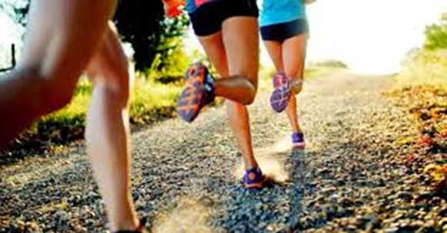
Extra Curricular
CROSS COUNTRY RUNNING
Saturday 25th September - High Hazels Park
Saturday 9th October - Norfolk Park
Saturday 6th November - Bradfield School
Saturday 20th November - Longley Park
Saturday 11th December - Castle Dyke Sports Centre
Saturday 15th January - Graves Park (City Championships)

Slide 31
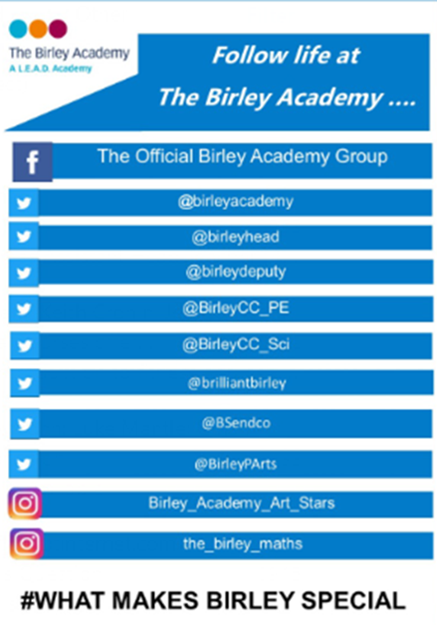
Communication
We believe that a good two way communication between Birley Academy and parents/carers is necessary in supporting students success. Over the year we will communicate with you using a variety of methods.
Go4Schools: This is our primary method of communication with you. You will receive a login, username and password to access information on Go4Schools. You will be able to access your child's account to look at details of their reward points and behaviour points.
Newsletters
Emails and phone calls
Parents Evenings
Students reports
School Website: www.birleysecondaryacademy.co.uk
We also have a number of social media websites which you can follow.

Slide 32
Key contacts
Matthewhunt@birleysecondaryacademy.co.uk
Progress Leader for Y7
Sarahyellott@birleysecondaryacademy.co.uk
Year Leader
Markjones@birleysecondaryacademy.co.uk
Deputy Headteacher for Behaviour and Attitudes and Safeguarding Lead
Diarmaidcasey@birleysecondaryacademy.co.uk
Deputy Headteacher for Quality of Education
Mariathomas@birleysecondaryacademy.co.uk
Assistant Headteacher for Adapted Curriculum and SENDCO)
Leoniegillham@birleysecondaryacademy.co.uk
Assistant Headteacher with responsibility for Teaching and Learning
Theresaclark@birleysecondaryacademy.co.uk
Assistant Headteacher with responsibility for Personal Development

Slide 33
Questions and questionnaire:
We will take questions individually (parent feedback)
We would greatly appreciate some feedback. Could you please take a few minutes and complete the sheet. We will use your feedback to improve future Parents’ Evenings.

