Slide 1

School mobile number = 0745 802 4611

Slide 2


Slide 3


Slide 4


Slide 5


Slide 6
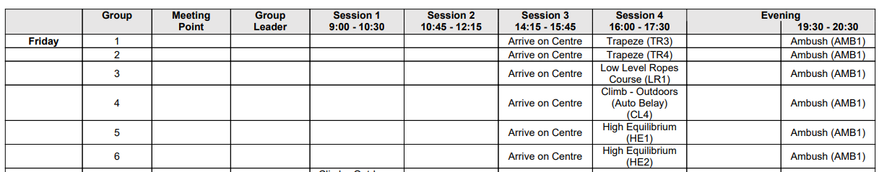
Students need to bring their gear including sleeping bags and pillows to school on Friday morning.
A member of staff will be present from 7.50 and bags will be stored in the PE department until we leave.
Students will go to line up and then at 12.30 they will go and collect their luggage from the reception area. We will then go down to the tram stop at approximately 1pm.
The coach is collecting us at 1.15pm. We will leave from the pull in opposite the tram stop if you want to wave goodbye.

Slide 7
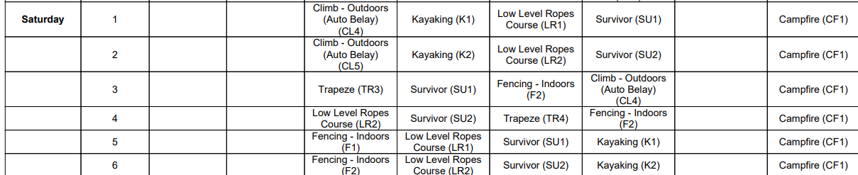
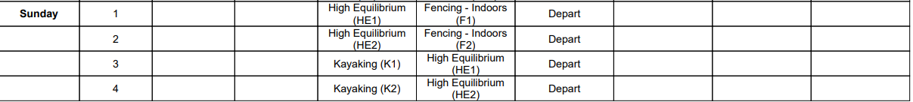
We are hoping to be back at school between 2 and 3 but we will keep you updated.

Slide 8

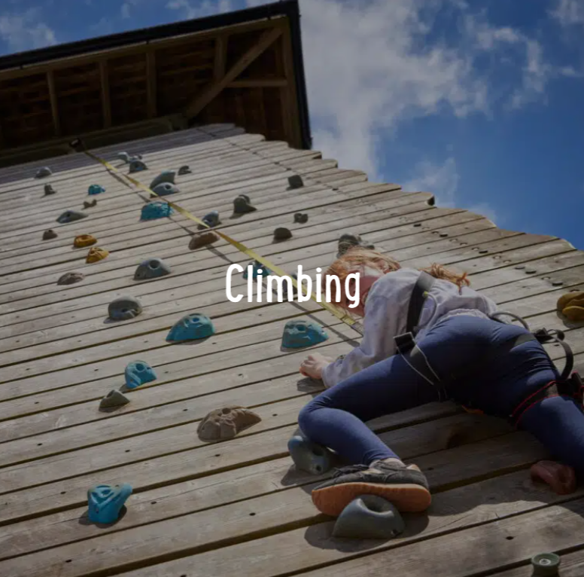
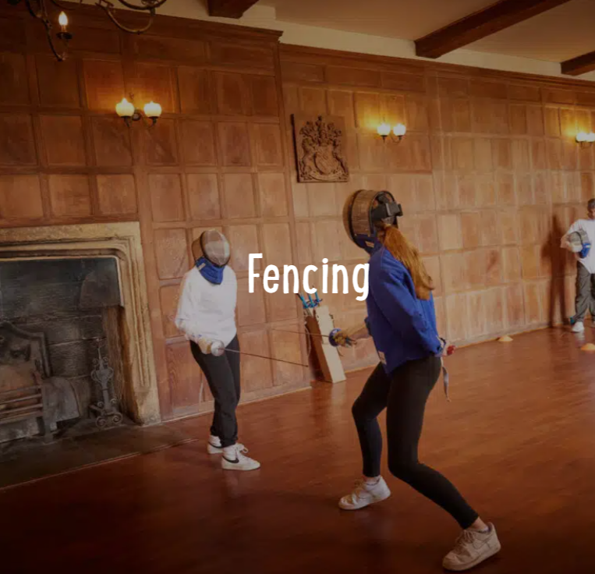
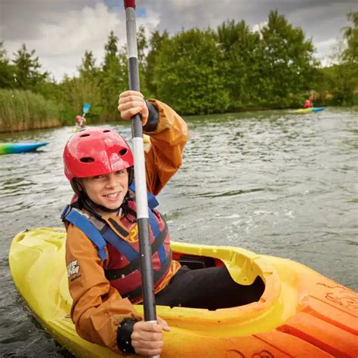
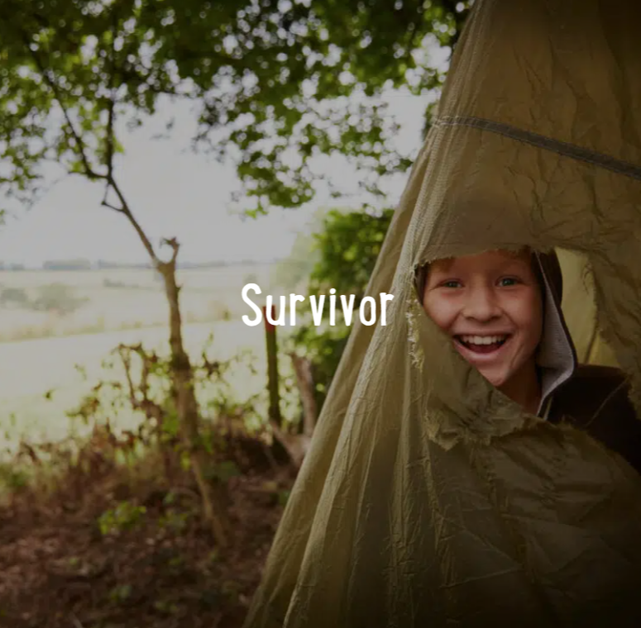

Slide 9


Slide 10


Slide 11


Slide 12
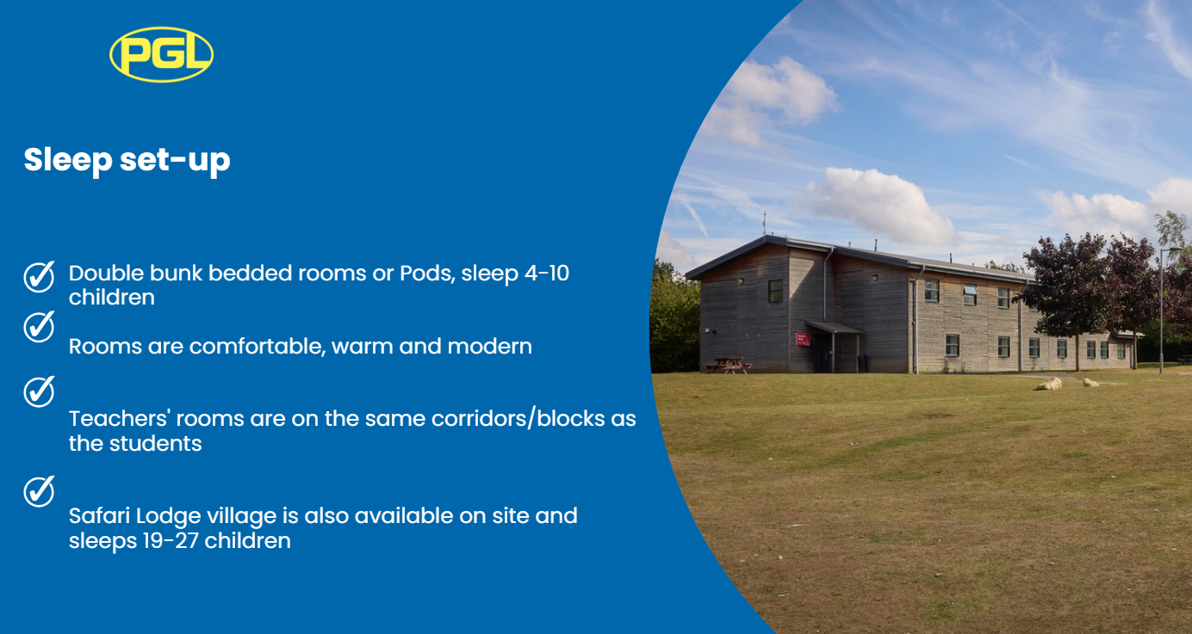

Slide 13
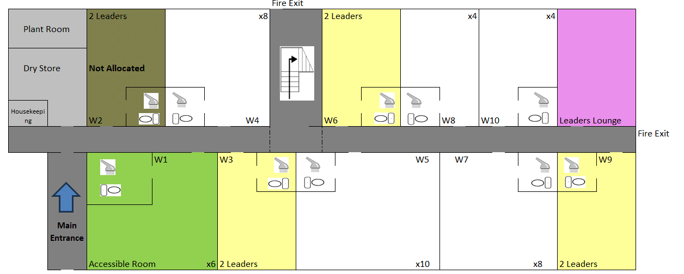
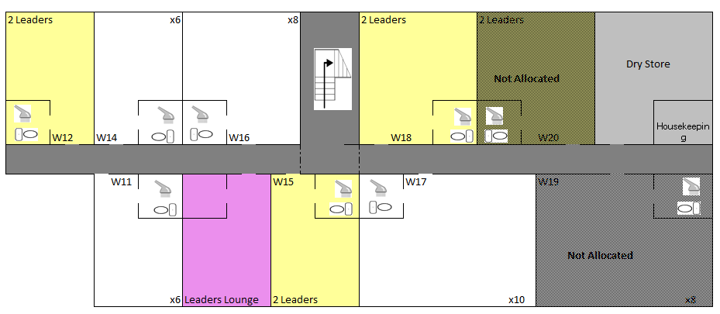
Students have been allocated rooms today.
Students may change their room when they get there but they MUST inform a member of staff so we can amend the fire list.
Students need to bring bedding.

Slide 14


Slide 15


Slide 16
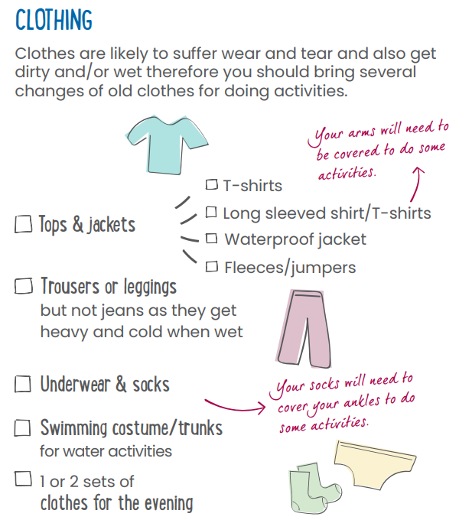
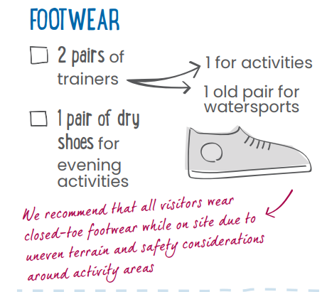
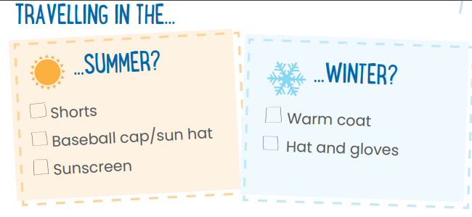

Slide 17
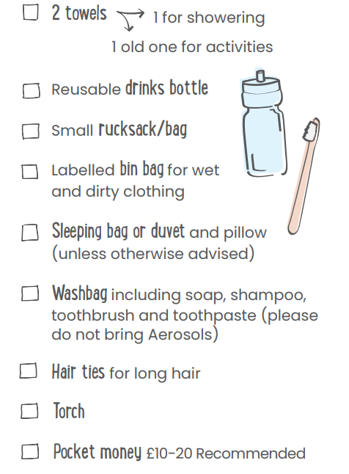
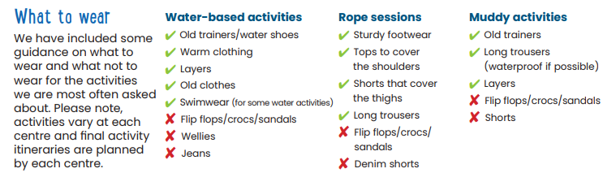

Slide 18
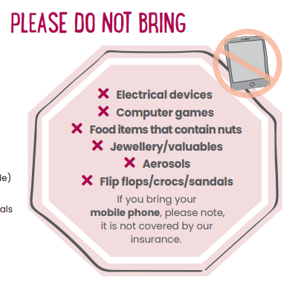
We want students to take photos and videos.
If they are on activity, they cannot use their phone for any other reason.
They must not take photos or videos of other people without their consent. This is a safeguarding issue and will be followed up in school if anyone raises a concern.
We are happy for students to use their phones when they are in their room at night but once lights are out then students must not be on their phone.
If we go into a room after lights out and students are on their phone they will be confiscated.
If your child contacts you with a concern, please ring us immediately.

