Slide 1

Interleaving Dual Coding Spacing
REVISION: INTERLEAVING, DUAL CODING AND SPACING
Boosting Your Memory and Learning Power
Boosting Your Memory and Learning Power

Slide 2

Interleaving Dual Coding Spacing
WHAT IS INTERLEAVING?
Mixing It Up
Interleaving: practice different topics/skills in one session, not just one.
Real-World Example
A football player practices passing, shooting, and dribbling, not just one skill.
Why It Works
Mixing topics helps connect ideas and improves long-term memory.
Improves retrieval
Holistic K&U
Boosting Your Memory and Learning Power

Slide 3
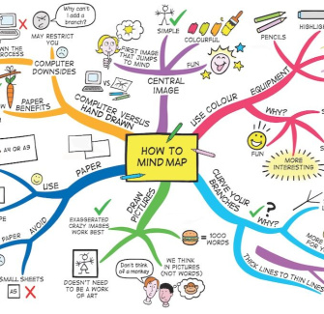
Interleaving Dual Coding Spacing
DUAL CODING EXPLAINED
Combining Words and Pictures
Dual coding is when you use both visual and verbal information together.
Real-World Example
For example, using diagrams or mind maps with written notes and pictures.
Making Learning Stick
By seeing and hearing information, your brain creates stronger memories.
Boosting Your Memory and Learning Power

Slide 4
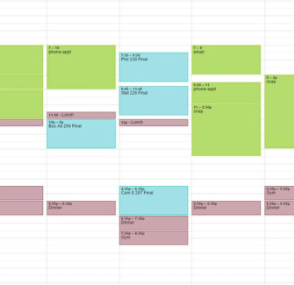
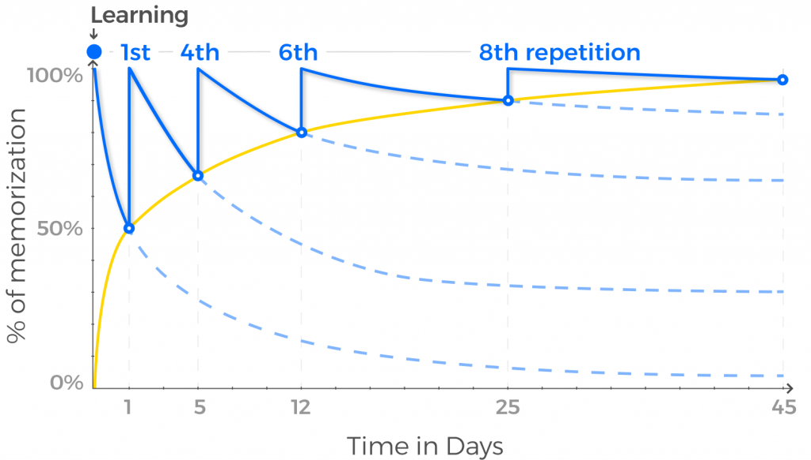
Interleaving Dual Coding Spacing
SPACING: THE POWER OF GAPS
Spreading Out Revision
Spacing means leaving time between study sessions instead of cramming.
Real-World Example
For example, revising a topic on Monday, then Wednesday and Friday.
Brain Benefits
-Spacing helps information move from short-term to long-term memory.
-Forgetting Curve.
Boosting Your Memory and Learning Power

Slide 5

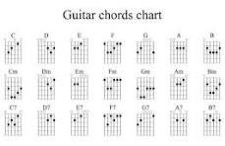
Interleaving Dual Coding Spacing
INTERLEAVING VS. BLOCKING
Blocking
Focus on one topic at a time (e.g. all English, then all Science).
Feels easier but can lead to forgetting.
When might blocking be useful?
When first learning a new skill.
Interleaving
Mix different topics or question types.
Feels harder but improves memory and understanding.
When is interleaving best?
Once you have some familiarity with the topics.
Interleaving = More realistic -----2 Exams per day
Boosting Your Memory and Learning Power

Slide 6
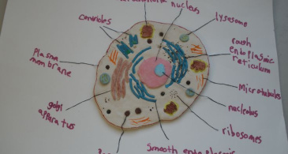

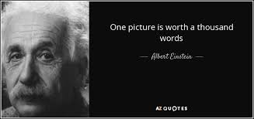
Interleaving Dual Coding Spacing
DUAL CODING IN ACTION
Draw a diagram of a science process.
Write a short explanation underneath.
Boosting Your Memory and Learning Power

Slide 7
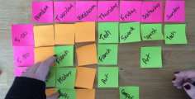


Interleaving Dual Coding Spacing
HOW TO USE SPACING
1
2
3
Plan Ahead
Make a revision timetable that revisits topics over weeks.
Short Sessions
Keep study sessions brief (30 mins) but regular for better retention.
Review Often
Go back to topics after a few days or a week to refresh your memory.
Little and often.
Boosting Your Memory and Learning Power

Slide 8



Interleaving Dual Coding Spacing
REAL-WORLD APPLICATION
Revision in Sport and Music
Top athletes and musicians use interleaving, dual coding, and spacing in their practice routines.
For example, a guitarist
Interleaving: Practises different pieces / chords
Spacing: Reviews them over several days
Dual Coding: Using sheet music (visual) and listening (verbal).
You Can Too!
Apply these strategies to your own revision for better results.
Boosting Your Memory and Learning Power

Slide 9

Interleaving Dual Coding Spacing
SUMMARY: SMARTER REVISION
Key Points
Interleaving: Mix different topics to make links and boost memory.
Dual Coding: Use both words and images for stronger learning.
Spacing: Spread out revision to remember more for longer.
Try these strategies in your next revision session to see real results!
Boosting Your Memory and Learning Power

Slide 10

Interleaving Dual Coding Spacing
REVISION STRATEGIES QUIZ
Question 1:
Explain the core idea behind 'interleaving' in your own words.
Question 2:
How does 'dual coding' help improve memory when revising?
Question 3:
Imagine you are revising for a history test. How would you apply the 'spacing' technique to your revision schedule?
Answers on the back...
Boosting Your Memory and Learning Power

Slide 11
Interleaving Dual Coding Spacing
​✅​
REVISION STRATEGIES QUIZ
Answer 1:
Interleaving involves mixing different subjects or topics during a single revision session to enhance learning.
Answer 2:
Dual coding strengthens memory by engaging both visual and verbal pathways in the brain simultaneously.
Answer 3:
To apply spacing, I would plan to revisit history topics across several days or weeks, rather than trying to learn everything in one long session.
Boosting Your Memory and Learning Power

