Slide 1


The Parent's Guide to "Brain Dump"
Helping Your Child Master Revision at Home

Slide 2

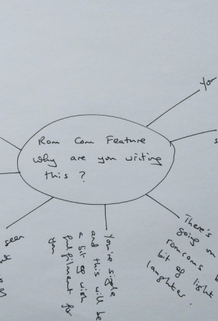
What is a Brain Dump?
A Simple Revision Tool
A "brain dump" is when your child writes down everything they remember about a topic, all at once, on a blank sheet of paper.

Slide 3

Why Does it Work?
Making Connections
When your child does a brain dump, they practise recalling information from memory. This helps strengthen what they know.
It also shows them what they remember well, and what needs a bit more work.

Slide 4


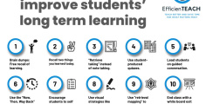
When to Use Brain Dumps
After Lessons
Try a brain dump after school to see what your child remembers from the day.
Before Revision
Use it at the start of a revision session to warm up their memory.
Before Exams
Great for checking what’s stuck before a test.

Slide 5

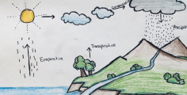
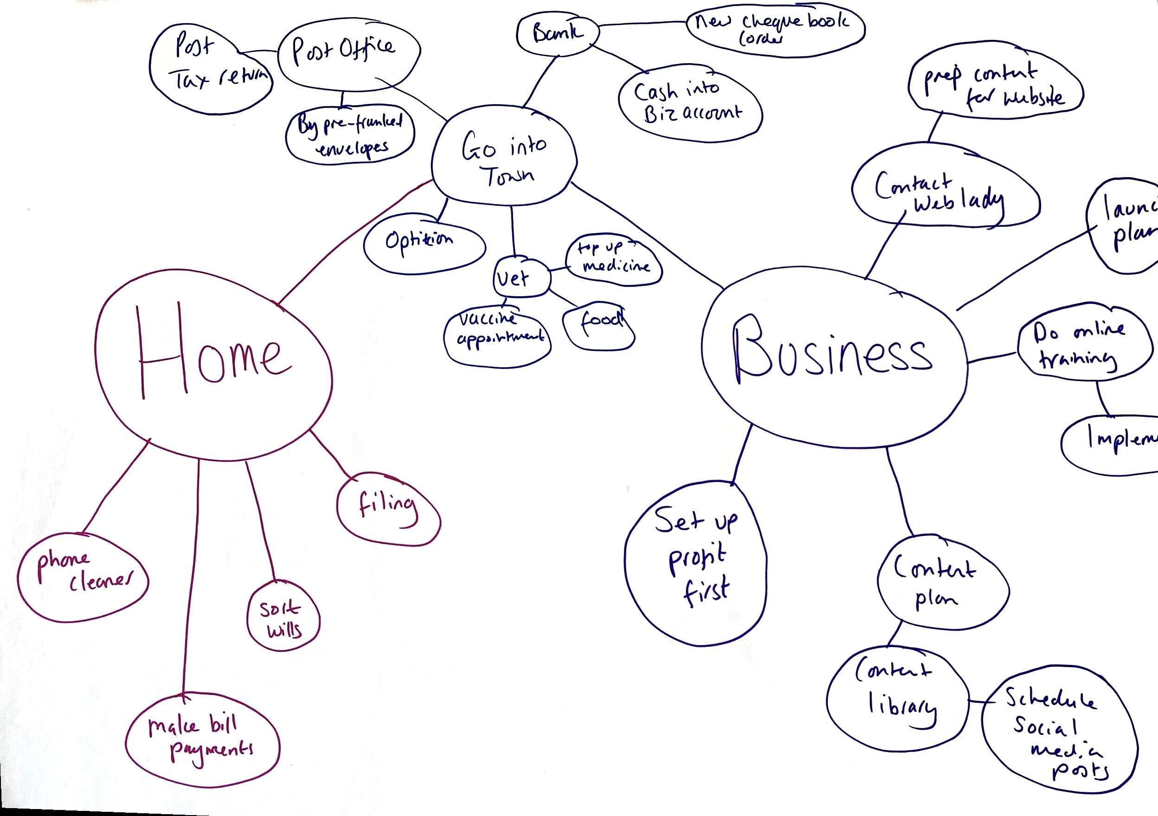
How to Do a Brain Dump
Get Ready
Give your child a blank sheet of paper and a pen.
Set a Topic
Pick a subject or topic to focus on, like 'The Water Cycle'.
Write It All
Ask your child to write down everything they remember—words, diagrams, facts.

Slide 6
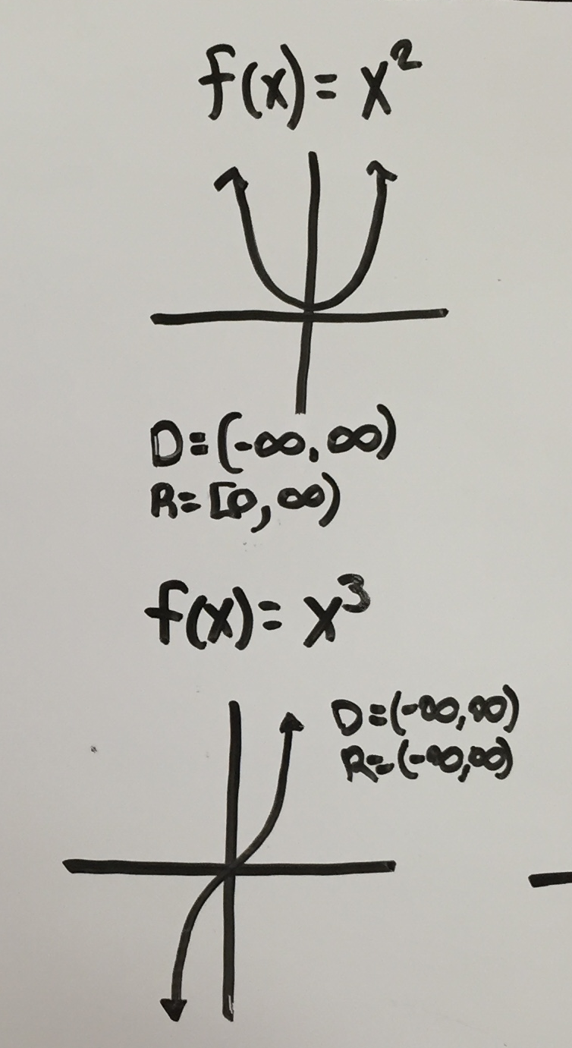
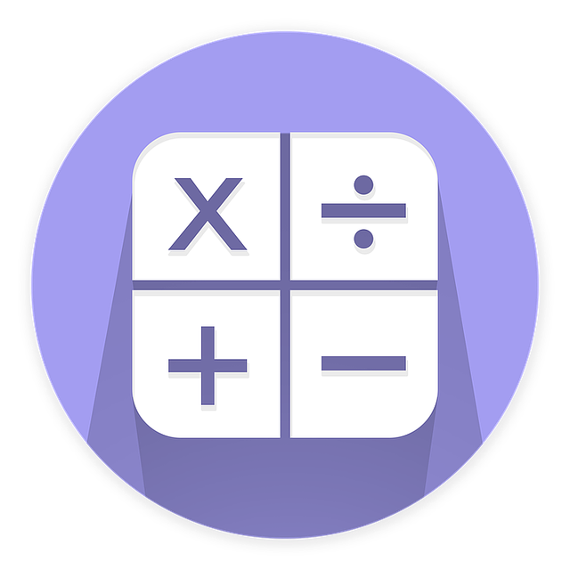
How to Do a Brain Dump
Get Ready
Give your child a blank sheet of paper and a pen.
Set a Topic
Pick a subject or topic to focus on, like types of graphs
Write It All
Ask your child to write down everything they remember—words, diagrams, facts.

Slide 7

Checking and Improving
What Next?
Go through your child’s brain dump together. Use their notes, textbooks or revision guides to spot what they missed.
Encourage them to add missing details in a different colour.

Slide 8


Your Own Brain Dump
Now it's your turn to try a brain dump!
Then, compare your brain dump to a fact sheet or guide on that topic, noting down anything you missed or remembered really well!

Slide 9
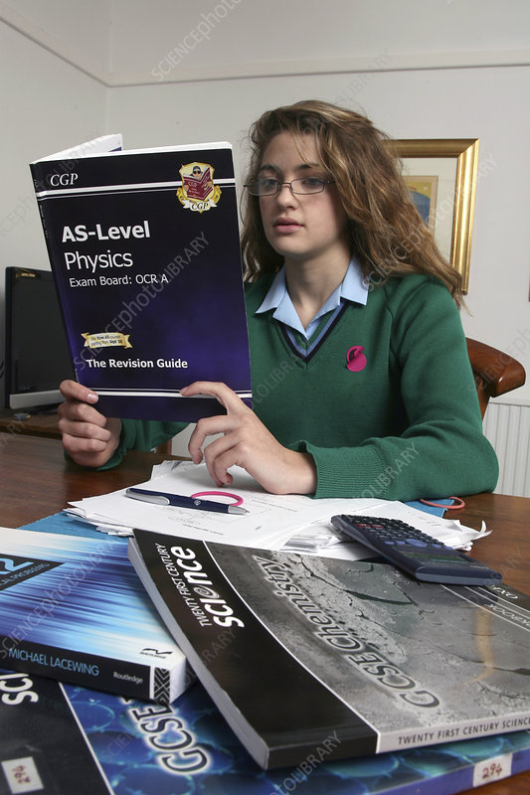
Summary: Supporting Success
Key Takeaways
Brain dumps are easy, active, and effective for revision.
They help your child see what they know and what to revisit.
With your support, your child can build confidence and independence in their learning.

