Slide 1


Supporting Year 11: Self-Quizzing for Revision
How Parents Can Help Pupils Use Powerful Revision Techniques

Slide 2


Why Revision Matters
The Challenge of Year 11
Revision is crucial for GCSE success. Many pupils struggle to remember everything, especially under exam pressure.
Parental Support
Parents can make a real difference by encouraging effective revision habits at home.

Slide 3
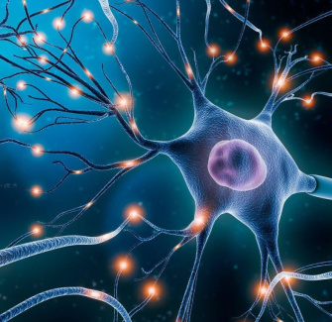
The Brain Science: How We Remember
Memory Works Like a Muscle
Each time we try to recall information, our brain strengthens those connections—just like exercising a muscle.
Forgetting is Normal
Without practice, we quickly forget new facts. Regular retrieval helps move knowledge from short-term to long-term memory.

Slide 4
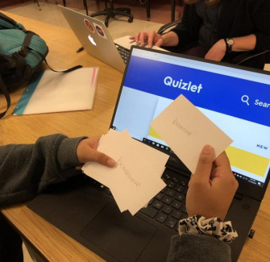
What is Self-Quizzing?
Active, Not Passive
Self-quizzing means testing yourself on what you’ve learnt, rather than just reading notes or highlighting.
Proven to Boost Memory
This technique encourages the brain to retrieve information, making it more likely to stick for exams.

Slide 5
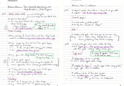



The Look - Cover - Write - Check - Correct Method
1
2
3
4
Look
Read a section of notes or a key fact you want to remember.
Cover
Hide the notes so you can’t see them anymore.
Write
On a blank sheet, write down everything you can remember.
Check & Correct
Compare answers to notes, correct mistakes, fill details.

Slide 6

Example in Action: GCSE Science
Step-by-Step
Look: Your child reads a summary of photosynthesis.
Cover: The summary is covered up.
Write: They write out the process from memory.
Check: They check for accuracy and fill in any gaps.
Why It Works
This method highlights what’s been forgotten, so pupils know exactly what to focus on next time.

Slide 7

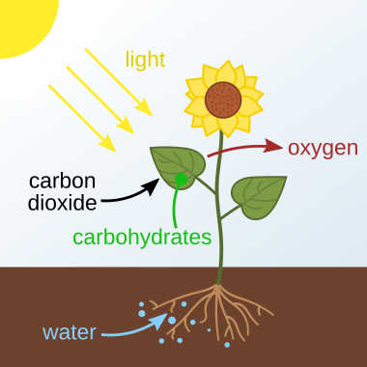
Applying Self-Quizzing
Photosynthesis is the process by which green plants, algae, and some bacteria use light energy, water, and carbon dioxide to create their own food (glucose) and release oxygen as a byproduct.

Slide 8


Think / Discuss! ​🤷‍♀️​ ​💁‍♂️​ ​💬​
Supporting Home Revision
Considering the Look-Cover-Write-Check-Correct method, what are some practical ways you might encourage or support your child to use this self-quizzing technique effectively at home?

Slide 9
Discuss! ​🤷‍♀️​ ​💁‍♂️​ ​💬​
​✅​
You might have said...
I'd set aside a specific time each day for revision using this method.
I could help them set up a dedicated revision space free from distractions.
I might quiz them on their corrections or help them find their notes.

Slide 10

Tips for Parents/Carers
How You Can Help
Create a quiet revision space.
Encourage short, regular self-quizzing sessions.
Ask your child to explain what they’ve just revised.
Celebrate effort, not just results.
Your support can build confidence and motivation.

Slide 11

Key Takeaways
Support Makes a Difference
Self-quizzing is a simple, research-backed way to boost memory.
The Look-Cover-Write-Check-Correct method is easy to use at home.
With your encouragement, your child can build strong revision habits for exam success.

