Slide 1


Year 11 Parents’ Revision Evening
Thursday 9th October 2025

Slide 2
Our research:
“One of the biggest challenges for students revising for GCSEs is not how much time they spend revising, but how effectively they use that time.”

Slide 3
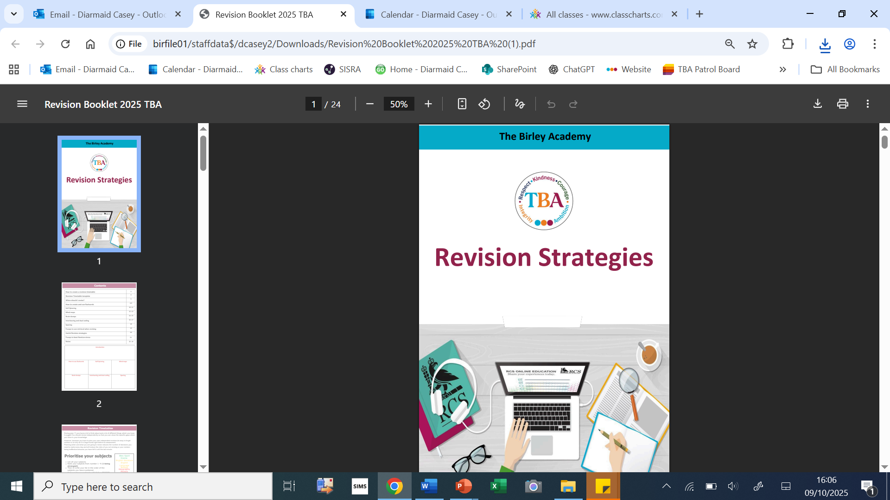
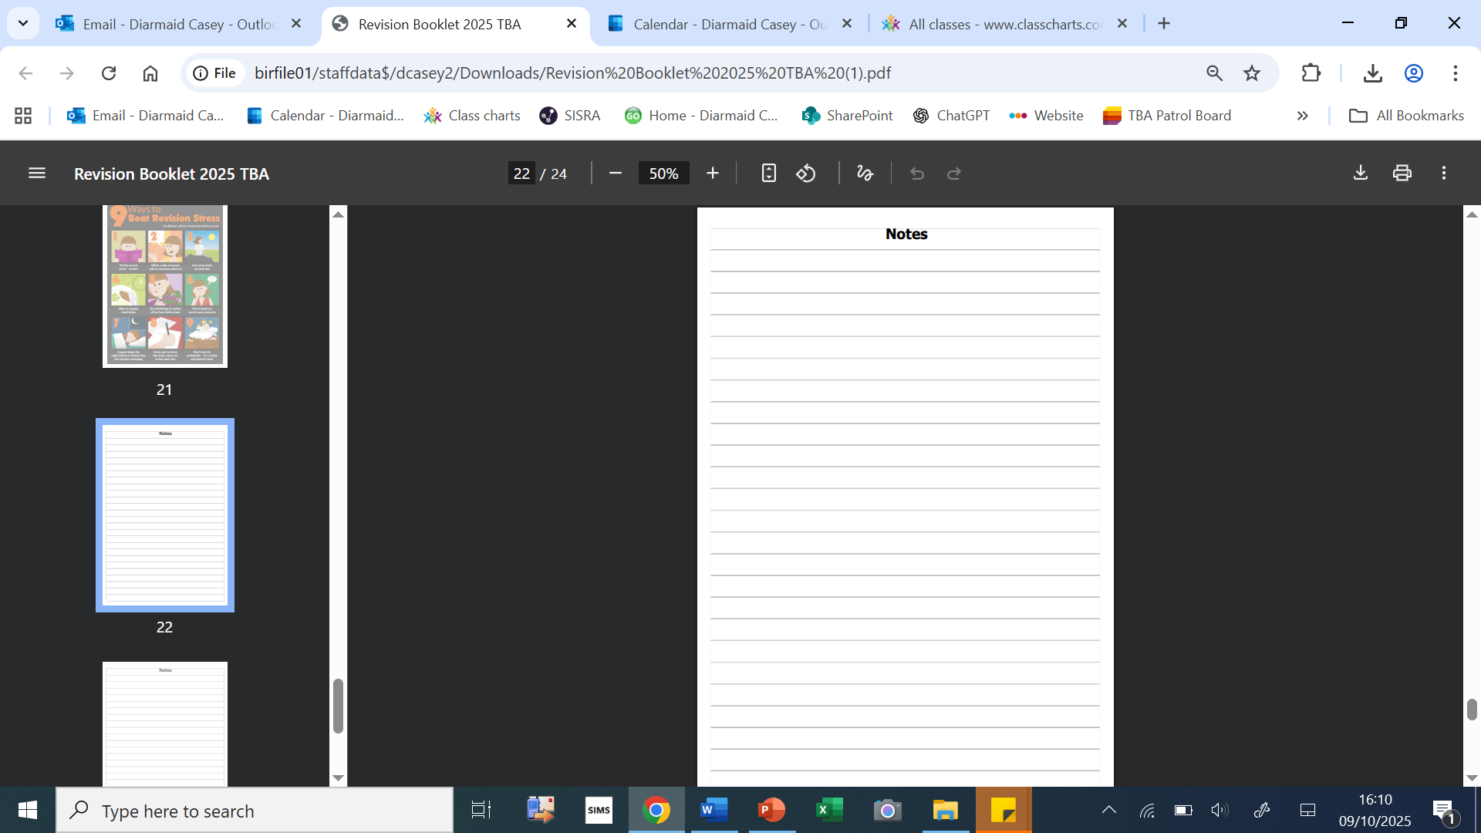
Booklet:
Back pages

Slide 4
Structure of the evening:
DT presentation
Carousel of revision techniques
Further information linked to revision
Opportunity for final questions

Slide 5
Parent Information Evening 9th October 2025
Design Technology Department
AQA GCSE Food Preparation and Nutrition
OCR Cambridge National - Creative iMedia
AQA GCSE – Design Technology (Resistant Materials)
OCR Cambridge National – Engineering Manufacture

Slide 6
The DT department offers P6 coursework ‘catch up’ sessions on the following days
Monday - Resistant Materials, Creative iMedia and Engineering
Tuesday – Food
Wednesday – Food and Creative iMedia
Friday – Food, Resistant Materials, Creative iMedia and Engineering
Exam preparation
Monday – Food
Saturday School and Easter School…

Slide 7
Overview of Expectations
Pupils revising at home. 20 to 30 minutes twice a week. 1 topic at a time
Revision materials are provided in the form of both paper based and online material/resources.
Homework is set and is all geared toward knowledge required for the exam.
Memory recall = Knowledge repetition
Revision timetable
Sunday | Monday | Tuesday | Wednesday | Thursday | Friday | Saturday
 | Math | English | RM | Science | iMedia
 | Food | History | Food | Engineering | RM
 |  | Engineering |  | Math

Slide 8

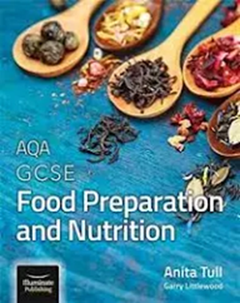
https://senecalearning.com/en-GB/
firstnamesurname21@students.birleysecondaryacademy.co.uk
Online e-book
https://www.illuminate.digital/aqafood/
UN: SBIRLEY3
PW: STUDENT3
£15 ‘hard copy’ on Amazon

Slide 9
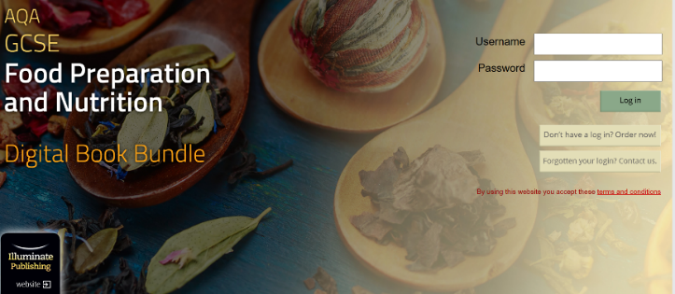
https://www.illuminate.digital/aqafood/

Slide 10
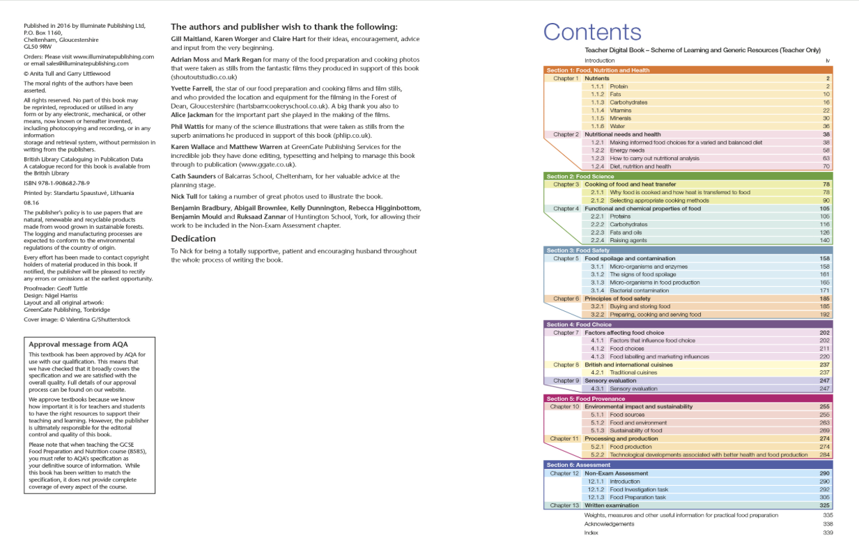

Slide 11
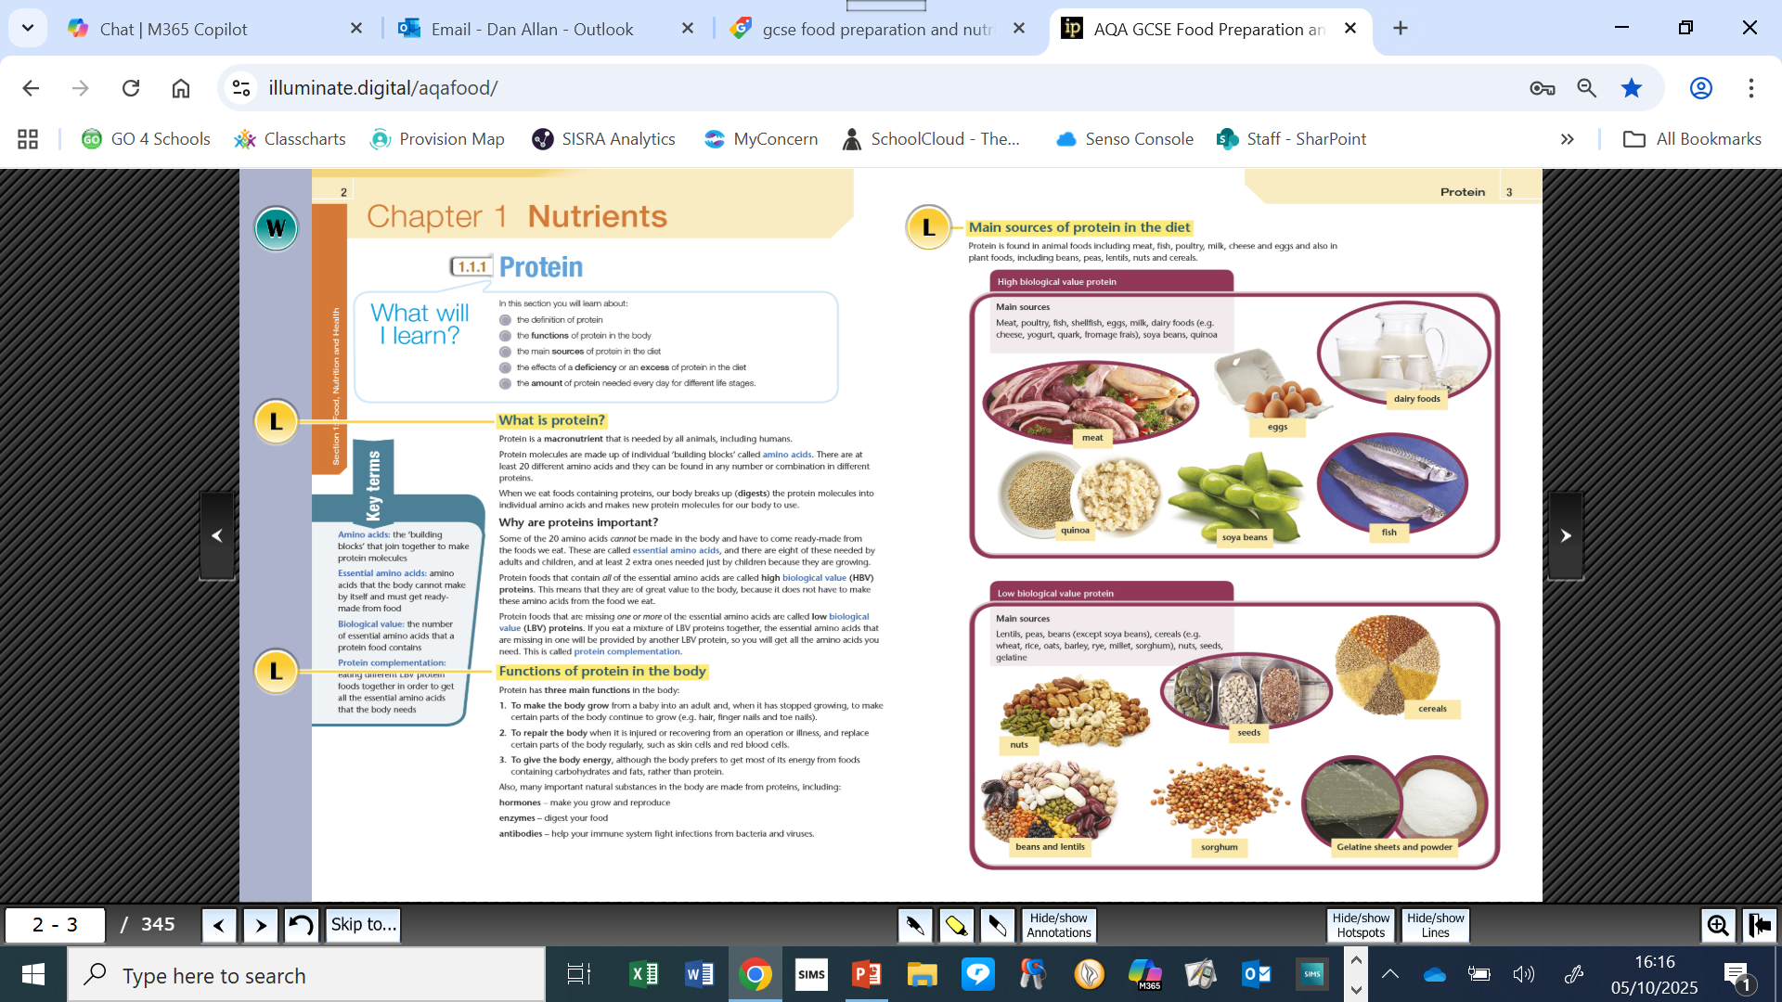

Slide 12
Recommended revision guides and question books (all can be purchased from all good book stores or on Amazon.
Pupils with just the revision book should pick 1 topic per session. This should be any topic they ‘struggle’ with or have little understanding of. Each topic is usually 1 page long. Pupils should read through this information 2 or 3 times. They should then put their book to one side and intentionally try to write down and record everything they can remember from what they have just been reading. This process makes the information far more likely to enter the memory than just reading. If they do not understand the information they should discuss with their classroom Teacher who will assist.

Slide 13
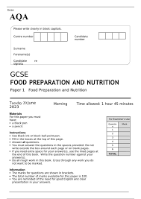
AQA past papers and mark schemes.
https://www.aqa.org.uk/subjects/food-preparation-and-nutrition/gcse/food-preparation-and-nutrition-8585/assessment-resources?f.Resource+type%7C6=Question+papers&sort=title&num_ranks=10
or
https://revisionworld.com/gcse-revision/food-preparation-and-nutrition-gcse-revision/gcse-food-preparation-and-nutrition-past-papers/aqa-gcse-food-preparation-and-nutrition-past-papers
These are best done in exam style conditions. Perhaps not all in one go but rather over 2 or 3 half hour sessions, then when completed and checked over, pupils should re-visit the paper with the mark scheme and go through the answers paying particular notice to how the mark scheme wants answers to be worded and what ought to be included.

Slide 14
Food Coursework
Pupils will be assessed in Year 11. They be assessed on three pieces of work:
NEA 1 – Food Science report
NEA 2 – Food Preparation Task
NEA 2 - 7 practical dishes.
4 Demonstrating skills dishes
The first of these will be on the last day of next half term (19th Dec)
3 final dishes (3 hour practical)
Final Exam (June in year 11) – 50% of your final GCSE grade.
Coursework makes up 50% of your grade and is the main focus in year 11, with revision tasks set as homework across the year ready for your final exam in June.

Slide 15
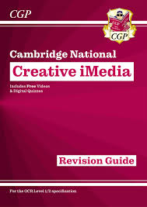
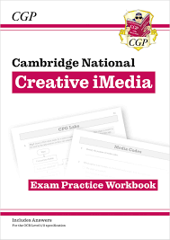
OCR - Creative iMedia
Pupils have been given homework revision booklets connected to topics they cover in lesson linked to their units of study. Students can use the internet to support revision or buy the following revision guide through SchoolComms on the school platform online or they can be purchased from other major book retailers.
https://www.cgpbooks.co.uk/secondary-books/vocational/other-vocational/cambridge-national-level-1-2/tmrn1-new-ocr-cambridge-national-in-creative?srsltid=AfmBOoqNpH3P1RaYI1N8XYyh14KMqJebcsiadaq-pXhhCFLCH4G6zRIp
Pupils will be given a second revision booklet after the half term break.

Slide 16
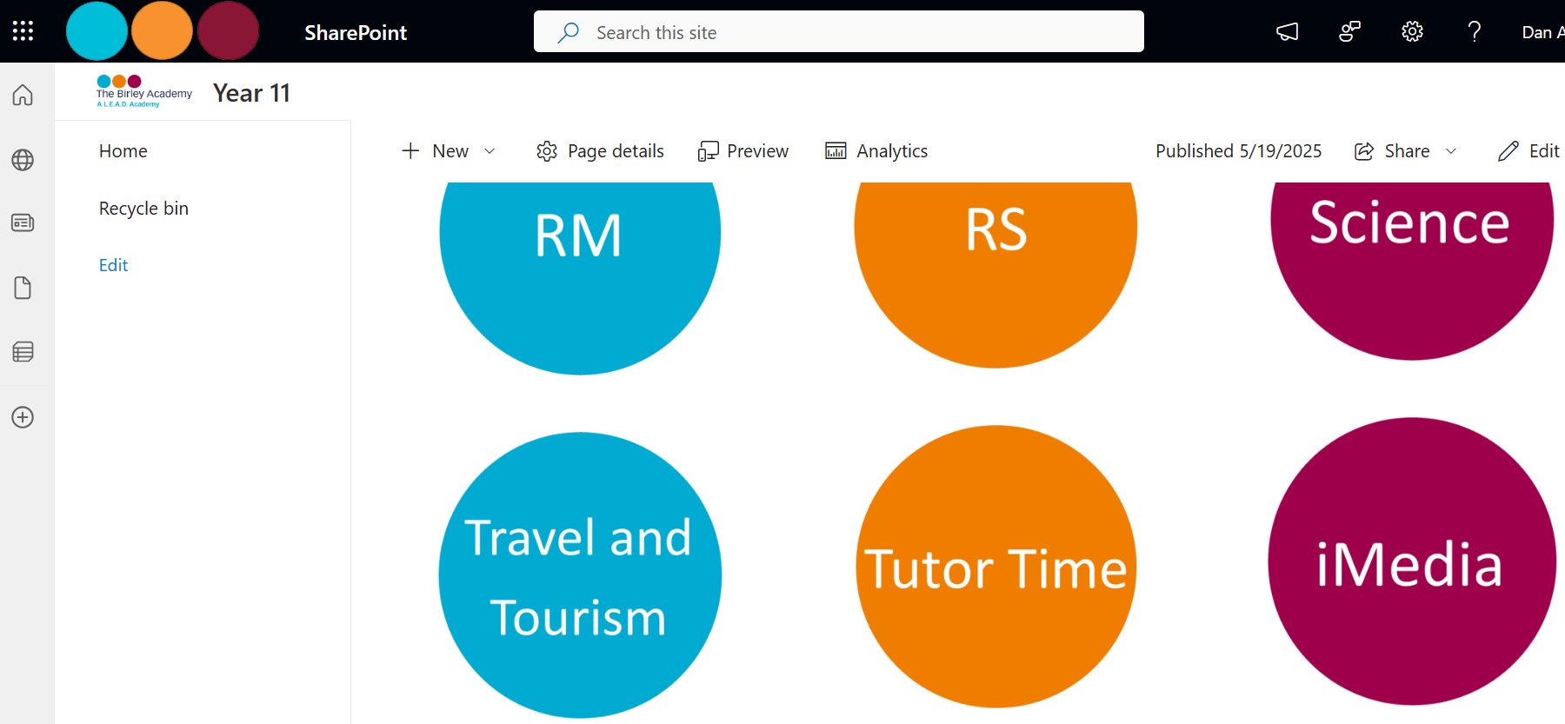
Student SharePoint
https://leadacademytrust.sharepoint.com/sites/BirleySecondaryAcademy/Year11

Slide 17
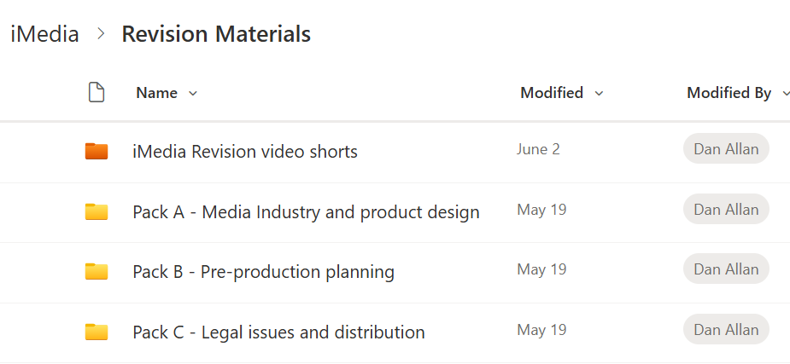
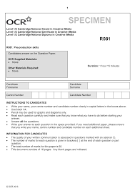
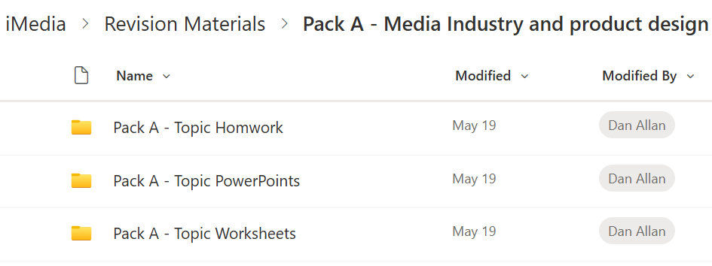
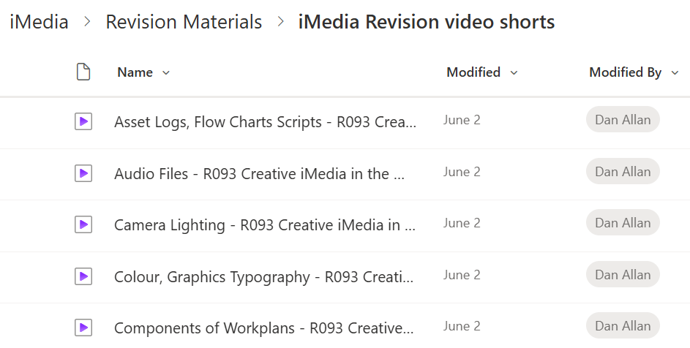
https://www.ocr.org.uk/qualifications/past-paper-finder/

Slide 18

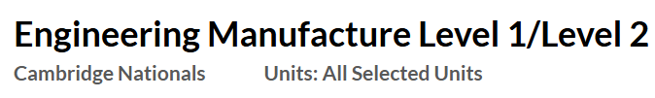
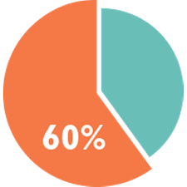
Grade:
40% - Exam
(May of year 11)
60% - NEA
Non-exam Assessment
(1 piece submitted in Y10 – 1 piece to be completed by end of Term 1 Y11)

Slide 19


AQA GCSE Design and Technology
Revision for Success
GCSE grade:
50% - 2 hour exam
(studied in Y10 – examined at the end of year 11)
50% - NEA
Non-exam Assessment
(completed throughout year 11)

Slide 20
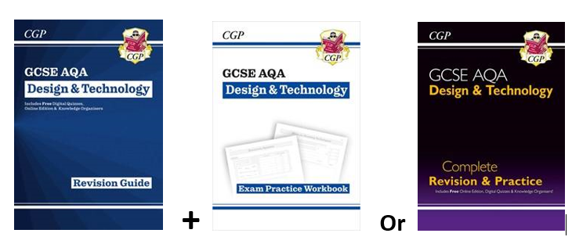
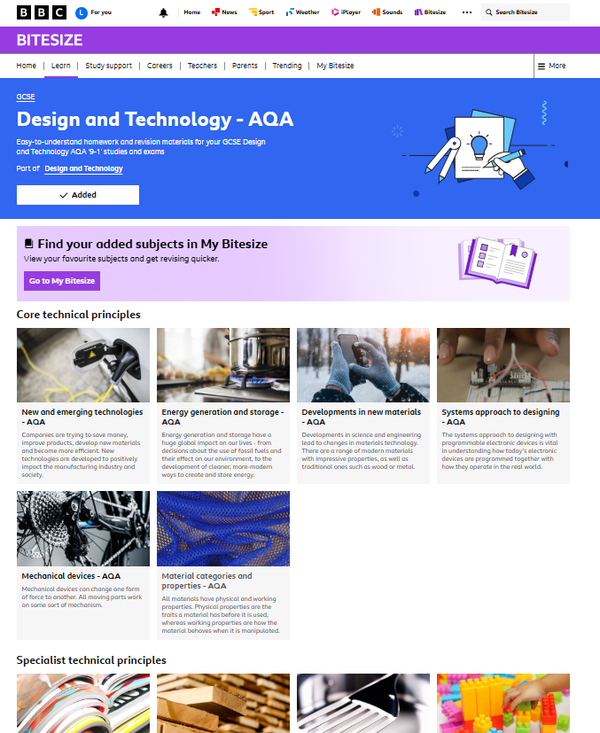
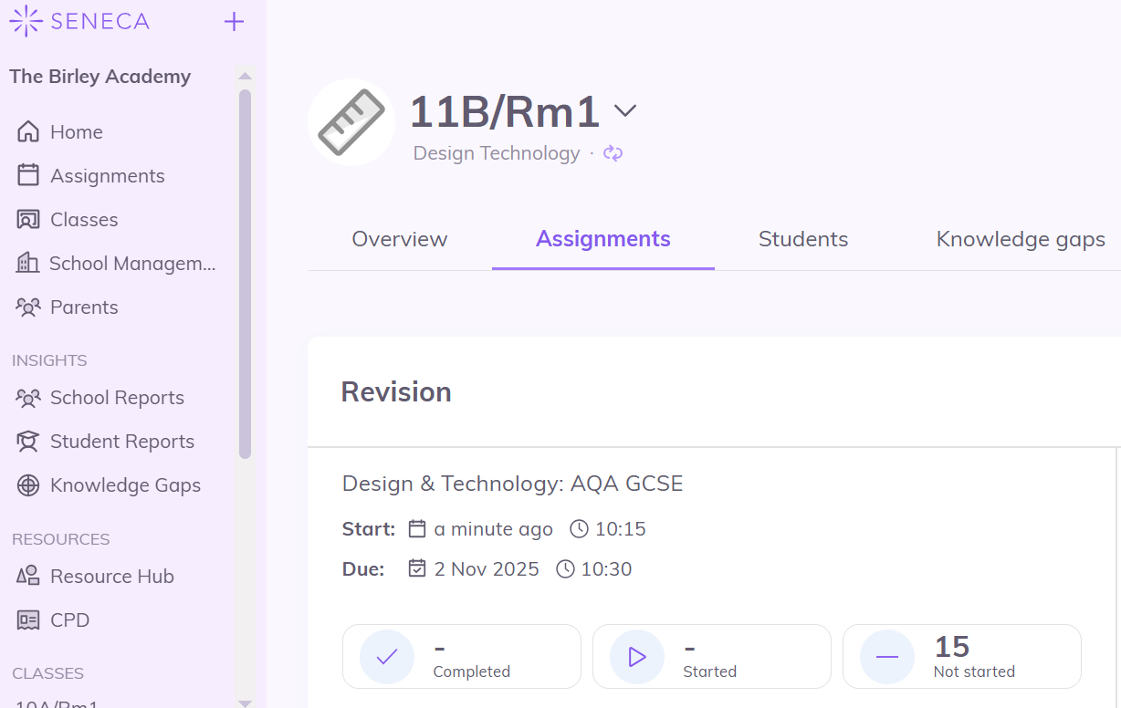
AQA GCSE Design and Technology
Revision for Success
The Best Tools - A Mixture is Key
Revision Toolkit A blend of online and physical resources is most effective:
CGP Revision Guide (Book)
BBC Bitesize (Online)
Seneca (Online)

Slide 21
CGP Guide: The 'Read, Cover, Write' Technique
Using the CGP Guide Effectively
Focus: Pick 1 topic you struggle with.
Technique:
Read the page 2-3 times.
Cover the book.
Write down everything you can remember
Recall use the corresponding ‘questions’ to test knowledge – checking back at the book when unsure.
This active recall is essential for memory.

Slide 22
Online Learning: BBC Bitesize
There are 3 main sections to the course and students should engage with the following:
Core Technical Principles – all of the topics in this section
Specialist Technical Principles – focus on Metals, Timbers and Polymers only
Designing and Making Principles – all of the topics in this section

Slide 23
Seneca:
Used for D&T homework, with full course access.
Provides instant marking and feedback on exam-style questions.

Slide 24
Introductions: Key people
Mr Casey: Assistant Headteacher / Leadership Team link, Year 11
Flashcards
Mr Child: Deputy Headteacher
Self quizzing
Mrs Sleaford: Deputy Headteacher
Mind maps
Mr Coleman: Assistant Headteacher
Brain dump
Ms Robinson: Assistant Headteacher
Interleaving, Dual coding, Spacing

Slide 25
What is revision?
Revision means going back over what has already been learned to help it stick in memory.
It’s how students refresh their understanding, fill any gaps, and prepare confidently for exams.

Slide 26

Carousel:

Slide 27
Carousel
Mr Casey: Assistant Headteacher / Leadership Team link, Year 11
Flashcards (Room 148 – Group A)
Mr Child: Deputy Headteacher
Self quizzing (Room 147 - Group B)
Mrs Sleaford: Deputy Headteacher
Mind maps (Room 146 – Group C)
Mrs Coleman: Assistant Headteacher
Brain dump (Room 145 – Group D)
Ms Robinson: Assistant Headteacher
Interleaving, Dual coding, Spacing (Room 137 – Group E)

Slide 28
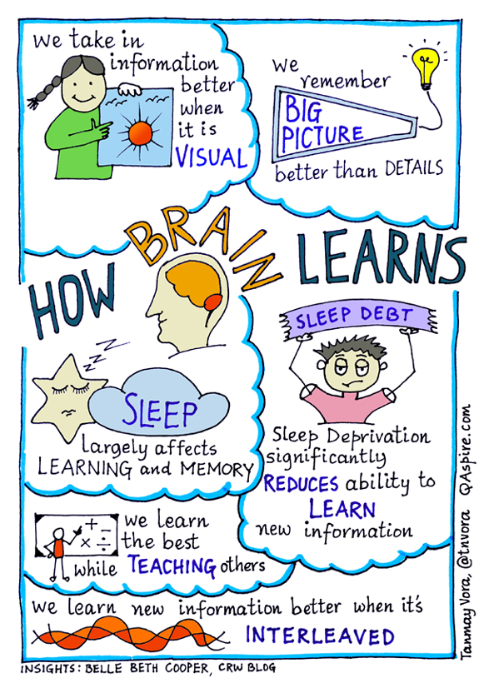
https://www.youtube.com/watch?v=uqGz7uqoPZ4
Key points:
Promoting effective learning / revision
Happy and relaxed
Water – helps reduce de-hydration & stress
Diet – balanced
Sleep
Temperature, e.g. too hot / cold
Exercise
Breaks
Multi-sensory learning

Slide 29

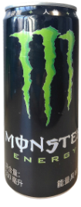
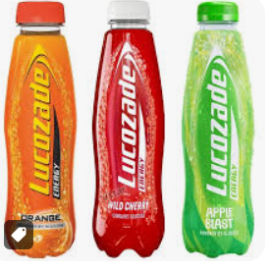

Slide 30
Sleep largely affects learning and memory:
Studies have shown that a good night of sleep can significantly improve performance.
Sleep deprivation can cut your brain’s ability to take in new information by almost 40%.
Question – what time is bed time?

Slide 31
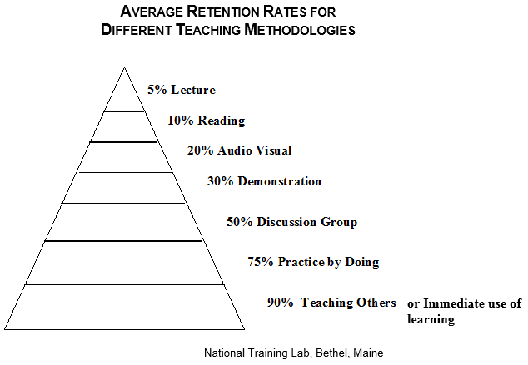
Better retention rates
The pyramid shows the average percentage of retention of material after 24 hours when a particular teaching methodology is the one primarily used.
We have known for a long time that the best way to learn something is to prepare to teach it. In other words, whoever explains, learns.”
(Sousa, How the Brain Learns)

Slide 32
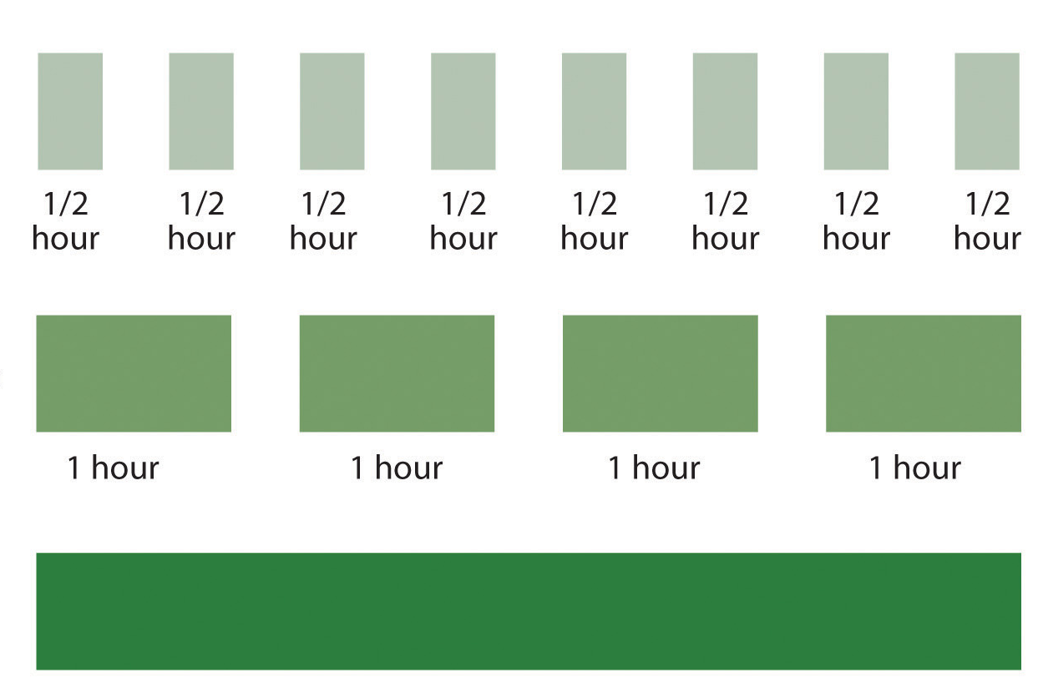
What is the best way to revise?
Most effective method is spacing
4 hours in one go

Slide 33
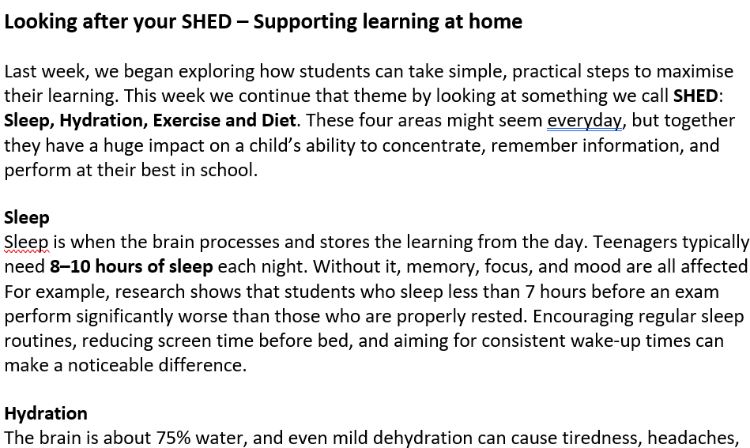
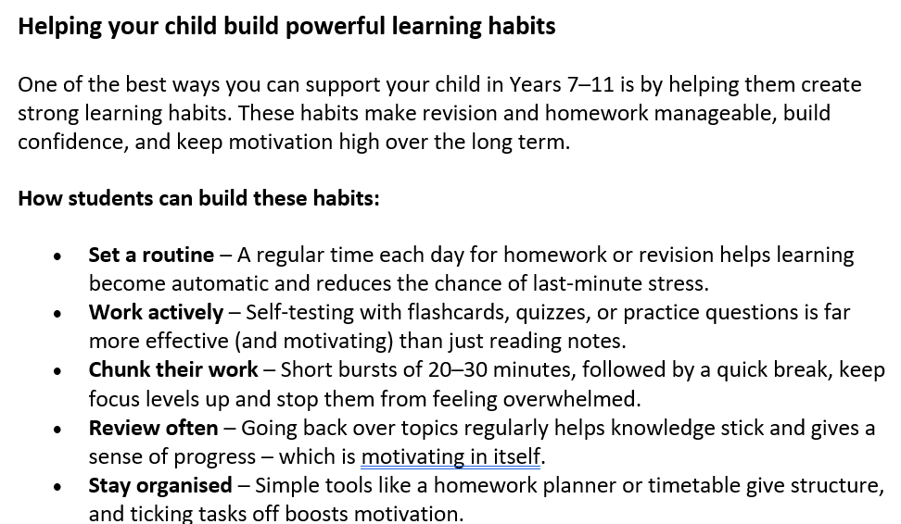
Parent Sway:
School website:
https://www.birleysecondaryacademy.co.uk/letters-newsletters/

Slide 34

Questions:

