Slide 1
Revision Techniques Mind Maps Sarah Sleaford Deputy Headteacher Quality of Education

Slide 2
Mind Maps
Mind mapping is the process of pulling ideas and linking information using colour, text and pictures
Why?
•Organise thoughts more productively
•Can see how facts relate to one another
•Review information effectively and quickly
•Remember more effectively
Use Mind Maps for...
-Recall/Revision
-Planning
-Making notes during a lesson

Slide 3
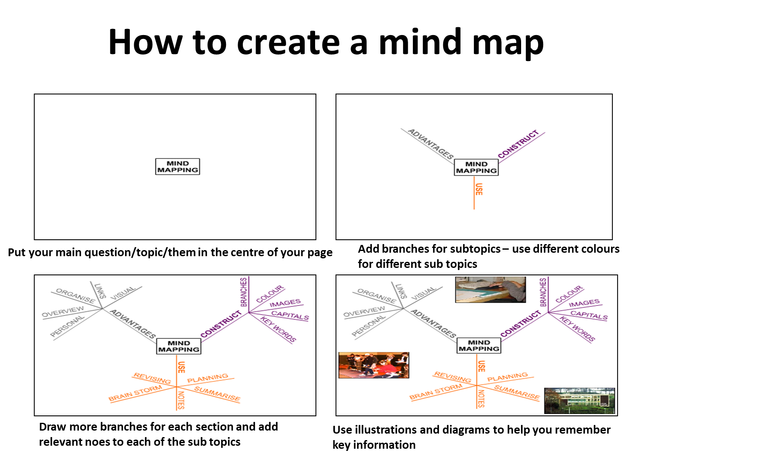

Slide 4
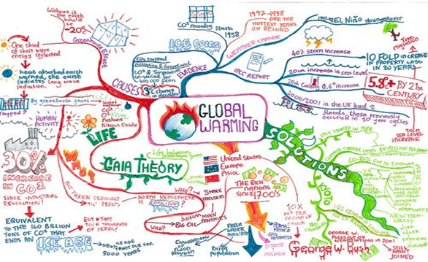
Examples

Slide 5
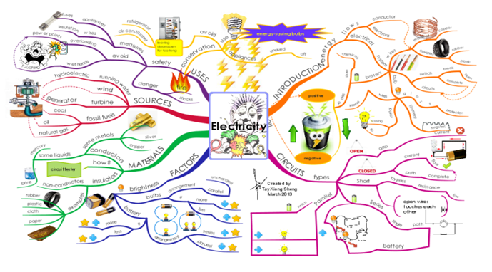
Examples

Slide 6
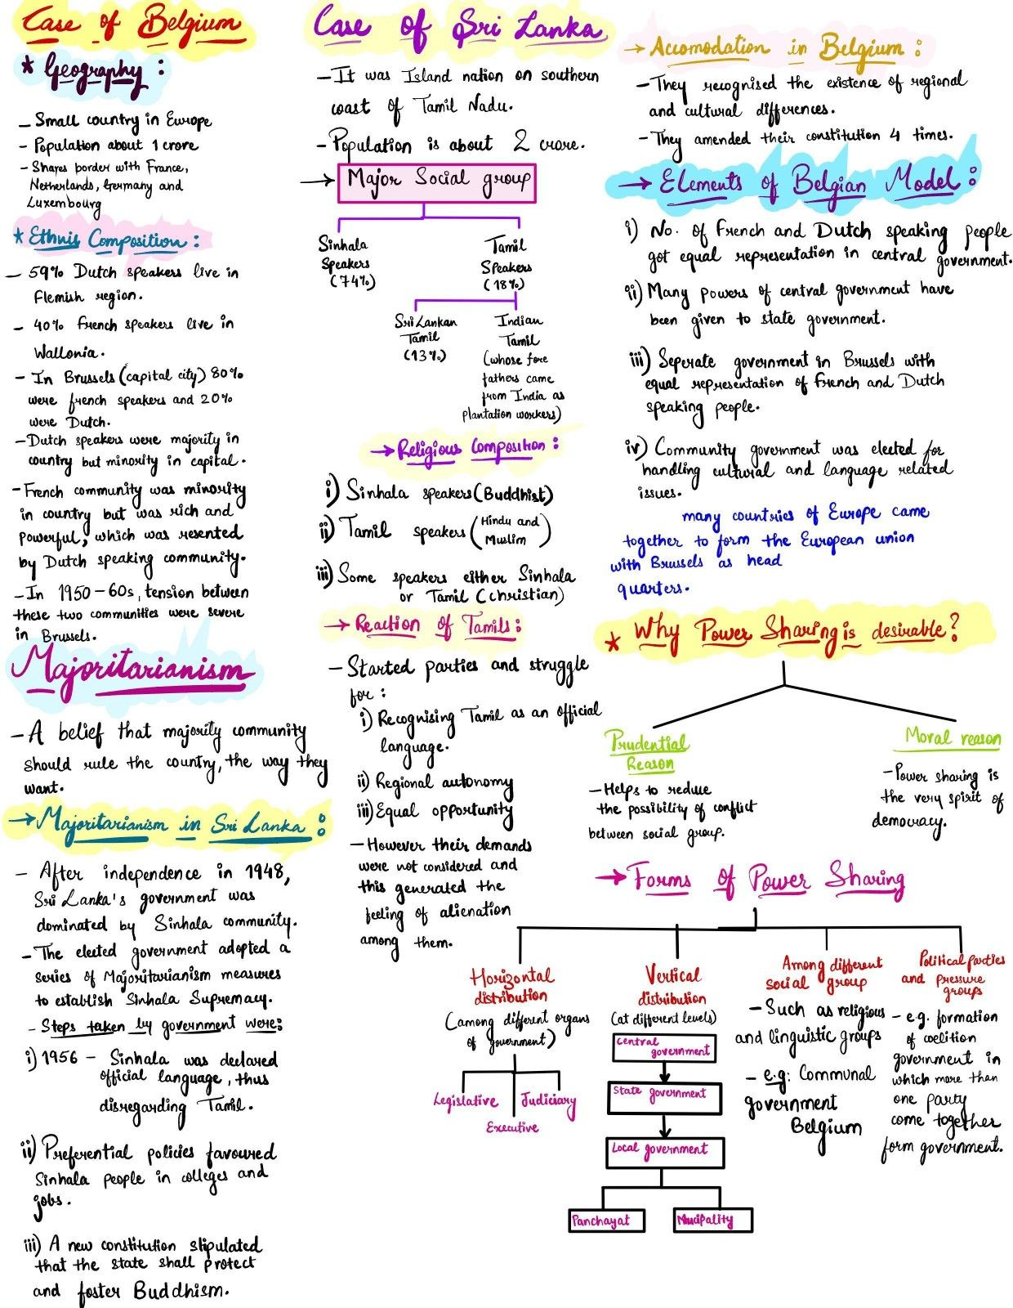
Examples
You Tube
https://www.youtube.com/watch?v=-Y1HJMuqAPY

Slide 7
2 Suggested Activities when mind mapping
Teach someone as you build
Using your own books try and identify the main topic and then add in what is the core knowledge (sub-topics) and begin to build the map together, let them teach you.
Timed Mind Mapping
Choose some revision notes that you have, or download some from bbc bitesize, on a topic of your choice.
Step 1 – 2 MINUTES - Read over this information-TURN IT OVER/LOOK AWAY
Step 2 - 2 MINUTES – Start your mind map
Step 3 - 2 MINUTES – Take another look at the information
Step 4 - 2 MINUTES – Continue with your mind map
Continue until you have finished your mind map. It is good to test yourself as you make up your mind map rather than just copying out information from your notes

Slide 8
Any Questions?

