Slide 1


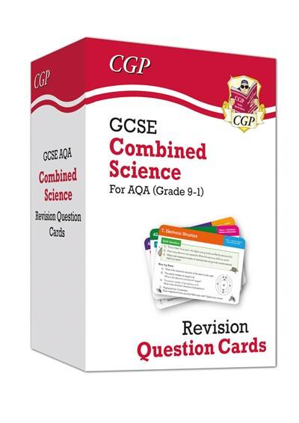


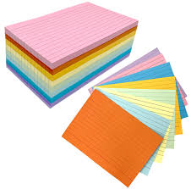
What are Flashcards?

Slide 2
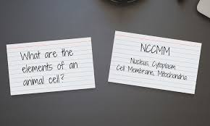
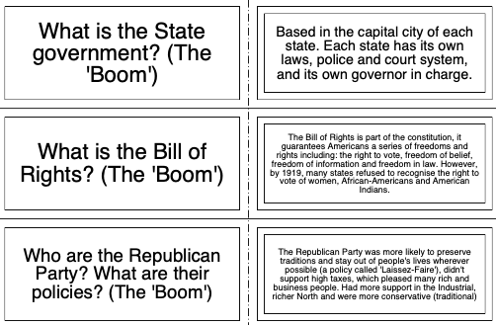
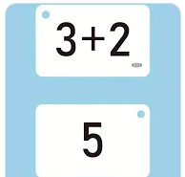
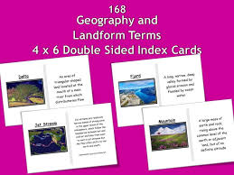
Example of Flashcards:

Slide 3
Why Flashcards work:
Flashcards work because they make your brain retrieve information rather than just re-reading it.
This process — called active recall — strengthens memory and makes it easier for students to remember facts in exams.
If students self-quiz regularly, their confidence grows and their knowledge sticks.
Key point
“Brain reads → forgets fast”
“Brain recalls → remembers longer”

Slide 4
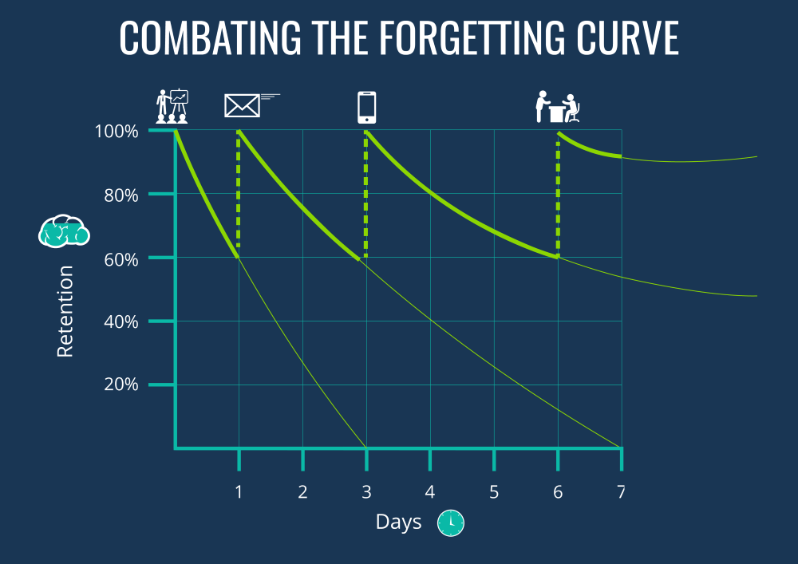
Ebbinghaus forgetting curve:

Slide 5
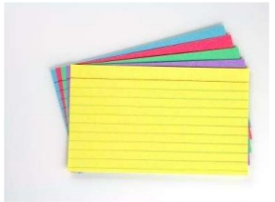
Flashcards: Why a good strategy?
Quick and easy way to revise knowledge
Easy way to test learning / can turn it into a game / quiz
Able to add images
Able to learn on the go, e.g. in the car; making a coffee for you
Supports multi-sensory learning
Reading or answering aloud
Using them to give you a presentation

Slide 6
How to create Flashcards that are effective:
Keep it short and clear.
Colour code by topic or exam paper.
History:
Medicine through time = Green cards (Exam paper 1)
American West = Blue cards (Exam paper 2)
Elizabethan England = Yellow cards (Exam paper 2)
Germany = White cards (Exam paper 3)
Use dual coding (simple images or symbols).

Slide 7
How to create a Flashcard:

Slide 8
WABOLL

Slide 9

How to use them:
Step 1: Shuffle and quiz.
Step 2: Sort into “Know it” / “Don’t know it yet” piles.
Step 3: Go over the “Don’t know it yet” cards until they move piles.
Step 4: Space out practice — a few each night is better than cramming.
You don’t need to know the content! Just read the question side, let your child answer, then check the back. You’re just the quizmaster.

Slide 10
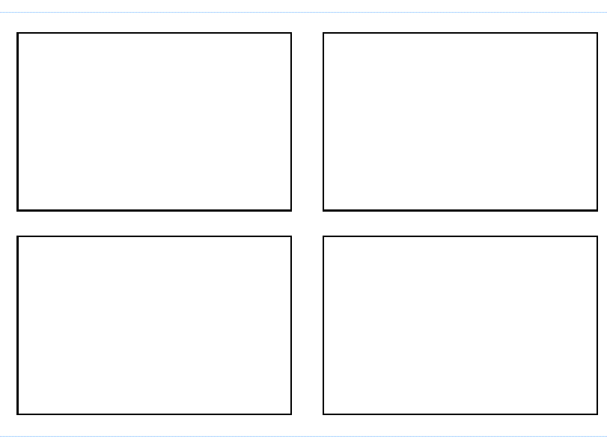
Template:

Slide 11
Questions?

