Slide 1
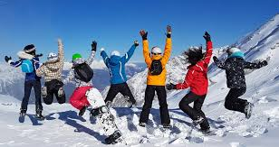
The Birley Academy SKI Trip 2026
HALSBURY SKI – Bansko, Bulgaria – One of the Best Ski Resorts for School Groups

Slide 2
When and Where?
Bulgaria - Bansko
Thursday 26th March 2026 – Tuesday 31st March 2026
Why Bulgaria?
Bansko has earned its reputation as Bulgaria’s premier winter sports destination through its impressive array of modern facilities and diverse range of ski slopes.

Slide 3
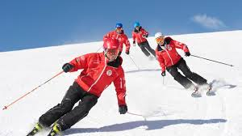
Can I go if I have never skied before?
YES
Notes:
YES – Suitable for all abilities

Slide 4
SLT Tours
Why are we using SLT Tours??
Fully bonded by ABTA and ATOL
A member of the Federation of Tour Operators (FTO)
Full member of the School Travel Forum (STF) adhering to a rigorous Code of Practice
24-hour telephone assistance in the case of an emergency
Awarded the Learning Outside the Classroom (LOtC) Quality Badge meeting the best practice standards set out by the LOtC
Have exceptional safety management systems in place, carry out risk assessments and only use the best and safest partners maintain strong supplier relationships and communications
Provide a personal, individual service where ski trips are tailored specifically for you and your students’ needs
Best Value for money

Slide 5
Included in your tour…
6 days/5 nights half board accommodation
20 hours skiing lessons with instructors
Lift pass for the entire resort (90km)
Ski in-Ski out resort (no need for transfers!)
Full premium equipment hire – Skis, poles, boots and helmet.
Range of apres-ski activities (Bowling, sledging, ice skating)

Slide 6
Included in your tour…
Full UK and overseas transfers
Return UK flights
1x hooded jumper for each student
Ski / Travel Insurance

Slide 7
Not Included in the total price…
Waterproof clothing (Ski jackets and trousers)
Lunch

Slide 10
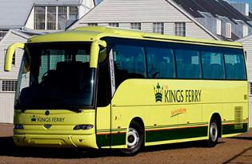
How are we going to get there?
Travel by plane and coach…
You need to have a valid UK passport – It has to have at least 6 months left

Slide 11
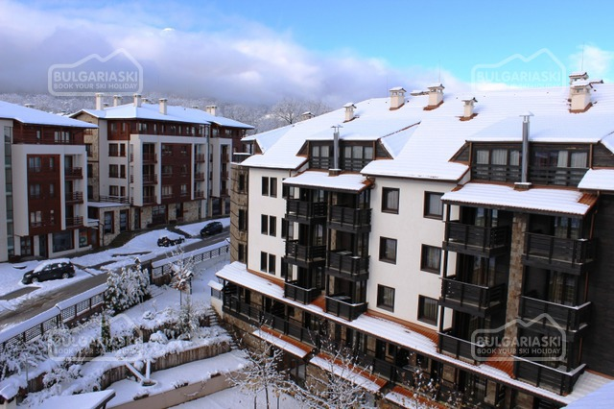
Casa Karina - Bansko
Hotel Rooms
54 deluxe double rooms or 64 apartments
All with private facilities
4* Hotel
TV, safe in adult rooms
Hotel Location
Set at the foot of Pirin Mountain, directly opposite the main gondola lift (around 100 m away) in Bansko’s modern ski resort

Slide 12
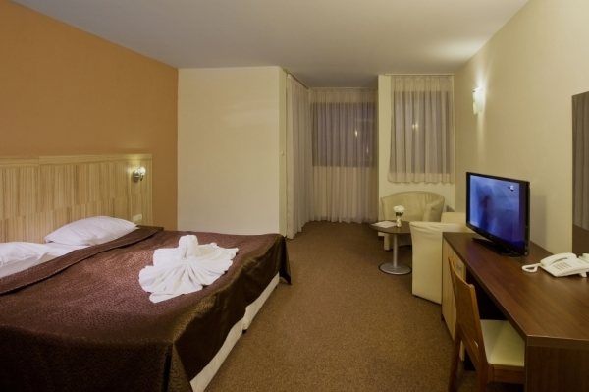
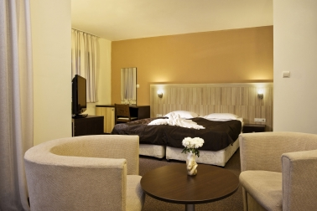
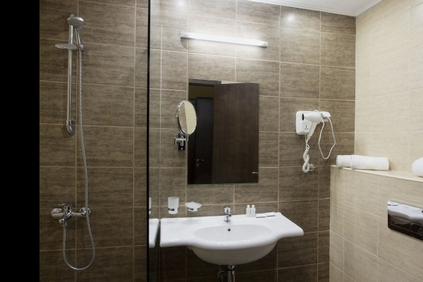
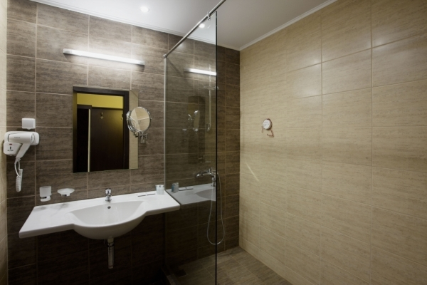

Slide 13
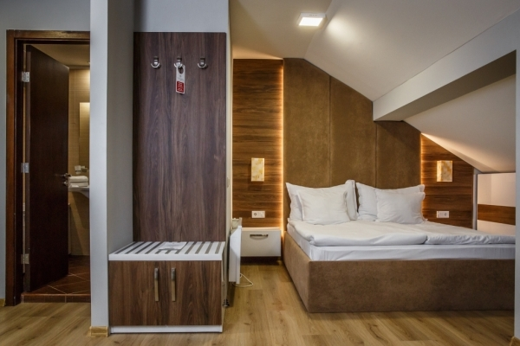
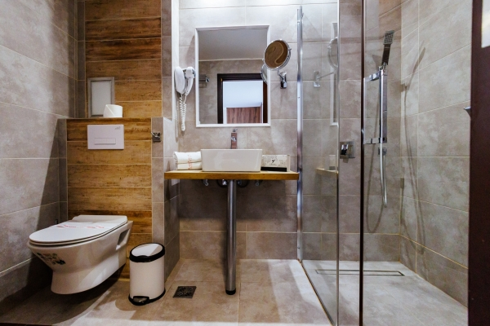
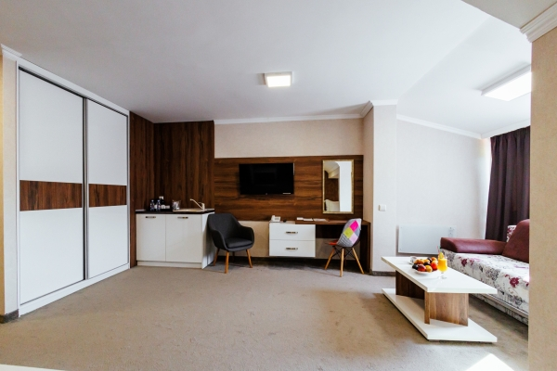
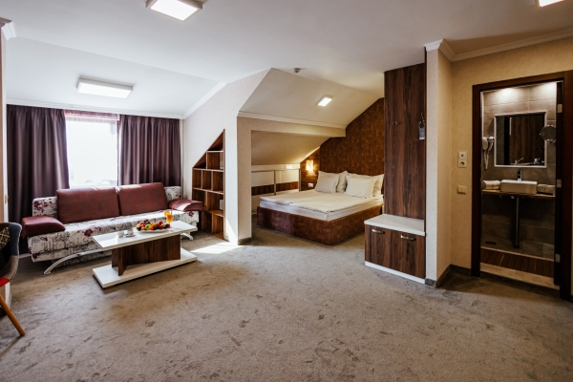

Slide 14
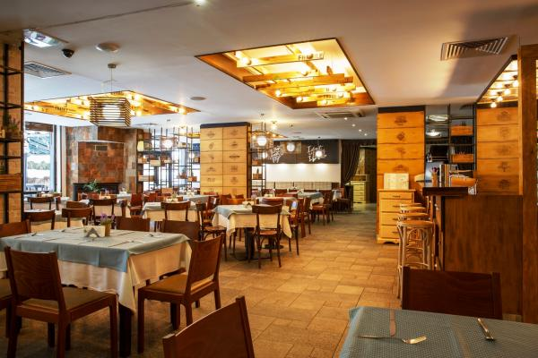
Facilities
Dining Room/Bar
Ski storage wardrobe
Games Room
Fast wifi
Meals
Breakfast buffet
Evening meal

Slide 15
What is the total cost of the trip?
£1349

Slide 16
How to pay for the trip
1st Deposit | £200 | Due by Friday 11th July 2025
2nd Deposit | £129 | Due by Friday 29th August 2025
1st instalment payment | £129 | Due by Tuesday 30th September 2025
2nd instalment payment | £250 | Due by Friday 31st October 2025
3rd Instalment payment | £129 | Due by Friday 28th November 2025
4th Instalment Payment | £129 | Due Wednesday 31st December 2025
5th Instalment Payment | £129 | Due by Friday 30th January 2026
Final Balance | £129 | Due by Friday 27th February 2026

Slide 17
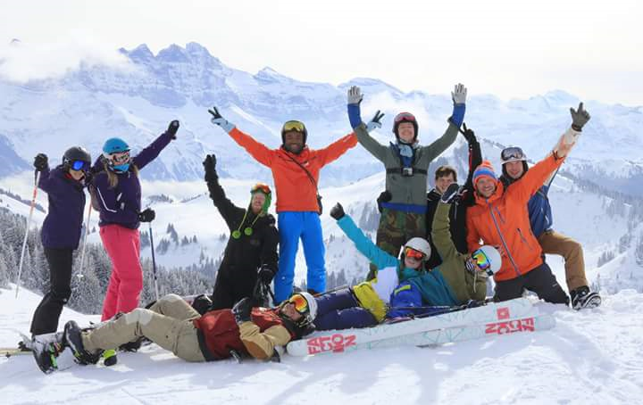
60 places

Slide 18
Questions

